Slide 1
Utilization Management
ASAP Annual Conference
Tuesday October 13th, 2015

Slide 2
Presented by: Pat Lincourt, OASAS
Boris Vilgorin, NYU/MCTAC
Kamala Greene Génecé, CASA/MCTAC

Slide 3
MCTAC Overview
What is MCTAC?
MCTAC is a training, consultation, and educational resource center that offers resources to all mental health and substance use disorder providers in New York State.
MCTAC’s Goal Provide training and intensive support on quality improvement strategies, including business, organizational and clinical practices to achieve the overall goal of preparing and assisting providers with the transition to Medicaid Managed Care.

Slide 4
Setting the Stage…

Slide 5
Medicaid Expenditures: 2013
$49.1 billion

Slide 6
Managed Care: Key Components
Care Management
Vertical and Horizontal service integration and coordination
Financial risk sharing with providers

Slide 7
Managed Care: Key Components Continue
Network of providers created via contracting
Utilization Management
Benefits package with a defined set of covered services
Contained list of covered pharmaceuticals (Formulary)
Credentialing

Slide 8
Triple Aim
Improve Patient Experience
Improve Health of Population
Reduce Cost of Healthcare

Slide 9
What is Utilization Management?
The process by which an MCO decides whether specific health care services, or specific level of care are appropriate for coverage under an enrollee’s plan
Primary purpose of the program is to ensure that services are medically necessary, appropriate, and cost-effective

Slide 10
Why do MCOs Conduct Utilization Management?
Managed Care is an integrated system that manages health services for an enrolled population rather than simply providing or paying for the services (outcomes, service quality and service expenditures).
Generally MCOs are paid for health benefits administration on a capitated basis (a fixed amount for each member each month/Per Member Per Month -PMPM).
The MCO’s role is to make sure the individual receives services in the least restrictive care
Involves a determination of whether the service is medically necessary and appropriate for the patient’s symptoms, diagnosis, and treatment and recovery. Also reviews for the appropriate length of care.
The core function of the UM program is to ensure that the MCO pays for only those services that are “medically necessary.”

Slide 11
What does it mean to be Medically Necessary?
Involves a determination of whether the service is necessary and appropriate for the patient’s symptoms, diagnosis, treatment, and recovery.
Many MCO contract definitions of “medically necessary” state that services may not be provided primarily for the convenience of the patient or the provider
New York State Department of Health requires the following definition of Medically Necessary:
Medically necessary means health care and services that are necessary to prevent,
diagnose, manage or treat conditions in the person that cause acute suffering, endanger
life, result in illness or infirmity, interfere with such person’s capacity for normal activity, or
threaten some significant handicap.

Slide 12
Types of UM Reviews?
UM will occur at different points in the healthcare delivery cycle:
Prior authorization: is a Service Authorization Request by the enrollee, or a provider on the enrollee’s behalf, for coverage of a new service, whether for a new authorization period or within an existing authorization period, made before such service is provided to the enrollee.
Concurrent review: is a Service Authorization Request by an enrollee, or a provider on Enrollee’s behalf for continued, extended or additional authorized services beyond what is currently authorized by the Contractor within an existing authorization period.
Discharge Review: occurs prior to discharge to assure that plans are in place for a safe and supported transition to another level of care or independent community living
Retrospective review: review that takes place, on an individual or aggregate basis, after the service is provided

Slide 13
Utilization Management Process
Review Level of Care (LOC) criteria as determined by LOCADTR for the service being requested/discussed
Review the specific information regarding the individual (presenting problem, current symptoms, medications, recent treatment) and formulate a rationale for the requested LOC and anticipated service units
Be Ready to Provide
Patient Name
Date of Birth (DOB)
Medicaid Number (CIN) and/or Insurance ID Number
Your Name
Facility Name and Contact Information
Identify the start date for treatment being requested
Request the services and number of service units (days, visits, etc.) necessary to deliver these services
Present rationale for request

Slide 14
Utilization Management Process Cont.
Discuss planned treatment changes (if any) and anticipated service units.
Might need to include overview of the long term treatment/support plan including discharge planning steps
Communication with other treatment providers
Family Involvement
Medications (new, existing, changes)
Patient involvement (person centered approach)
Obtain decision from MCO, document
If adverse decision:
Request rationale and Alternative Treatment
Consider MD to MD review
Appeal

Slide 15
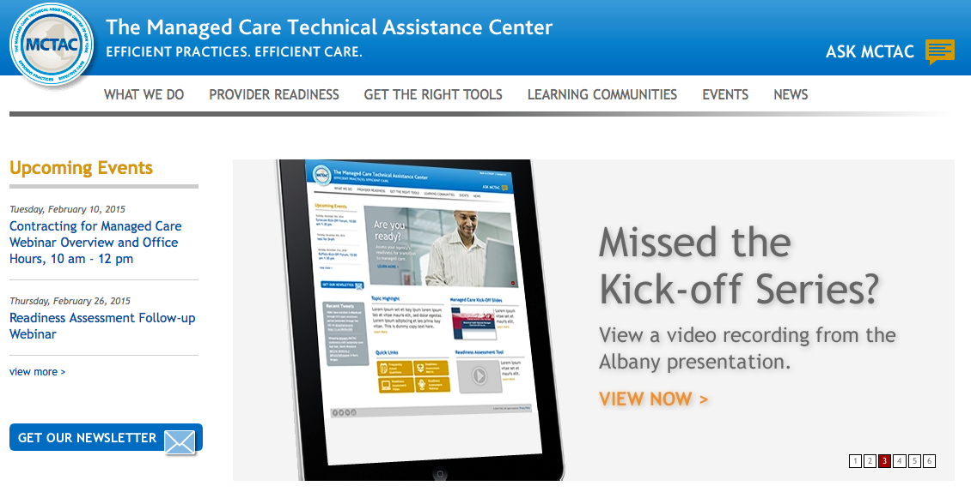
Thank you for participating!
Visit www.mctac.org to view past trainings, sign-up for updates and event announcements, and access resources.
@CTACNY
mctac.info@nyu.edu

Slide 16
The role of the locadtr in utilization management

Slide 17
Overview
The most common utilization management techniques are:
Precertification,
Concurrent review, and
Case management
The LOCADTR can be utilized at these points as a component of utilization management

Slide 18
UM Clinical Explanations
Precertification/Notification
Understand medical necessity language and how it applies to respective levels of care
Be prepared to present clinical information to support level of care recommendation
Inpatient: withdrawal symptoms, risk for medical/psychiatric complications, need for supportive environment
Outpatient: severity and frequency of use, need for rehabilitation skills
OTP: inability to maintain sobriety without MAT
Develop process for communicating LOCADTR information to plans

Slide 19
UM Clinical Explanations
Concurrent Review
Provide a summary of effectiveness and progress in treatment
Document that services in treatment plan are appropriate to patient needs
Document the need for continued services
Case Management
Recommend additional services to maintain progress and/or forestall relapses

Slide 20
Clinical Examples of LOCADTR Use
Step down
Client has completed inpatient rehab and is transitioning to intensive outpatient
Relapse
Client has attended 3 months of outpatient services and begins to use heavily again
Needs supportive environment to discontinue use
Transition
Client’s living situation has changed/obtained employment and requires a different level of care

Slide 21
Outlier Management
Plans may conduct UM reviews on cases that are deemed “outliers”
Possible examples include:
IOS services longer than 6 months
6x per week pick-up schedule without clinical intervention longer than 1 year
Greater than 1 Detox admission within 30 days
Provide clinical rationale for treatment decisions
Document clinical progress and or need to remain at the level of service being delivered

Slide 22
Patient Confidentiality
Ensure that patients have signed release of information/consents for MCOs
Educate patients regarding the communication with MCOs
Discuss implications of MCO decisions

Slide 23
Administration Considerations
Set aside time for MDs to respond to peer-to-peer reviews
Revise clinical documentation to incorporate concurrent review requirements
Research and develop alternative levels of care

Slide 24
Thank you

