Slide 1
Innovative and “New” Medications to Treat our Worst Nightmare-
New York State
“Opioid” Epidemic Crisis
Presented by
Caroline Waterman, MA, LRC, CRC, Executive Director, COMPA
Sonia Lopez, MD, Medical Director, START
Sarah Church, Ph.D., Executive Director, Division of Substance Abuse, Montefiore Medical Center

Slide 2
Introductions
Caroline Waterman MA, LRC, CRC
Sonia Lopez, MD
Sarah Church PhD

Slide 3
Overview
Medications
Integrating New Medications
Vivitrol
Buprenorphine
Interactions with other medications
Preparing Staff
Billing
Electronic Health Records
Procurement
Policy and Procedures

Slide 4
MAT - Medication Assisted Treatment
What have you heard about Vivitrol and Buprenorphine?
What are your major concerns regarding these two medications and MAT patients?
Notes:
Sticky notes and have the participants write what they have heard about

Slide 5
MEDICATIONS

Slide 6
Only (3) FDA
Approved Medications
1947 - Methadone - full agonist
2002 - Buprenorphine/naloxone - partial agonist
2006 - Injectable Naltrexone/Vivitrol – an antagonist
Notes:
Blue- write each of the names and then pass out sticky notes to put on what have you heard about:
Methadone - full agonist
Buprenorphine/naloxone - partial agonist
Injectable Naltrexone/Vivitrol – an antagonist

Slide 7
Methadone
Methadone is offered in pill, liquid, and wafer forms and is taken once a day. Pain relief from a dose of methadone lasts about four to eight hours. SAMHSA's TIP 43: Medication-Assisted Treatment for Opioid Addiction in Opioid Treatment Programs – 2008 shows that methadone is effective in higher doses, particularly for heroin users, helping them stay in treatment programs longer.

Slide 8
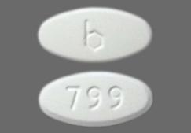
Buprenorphine
1st visit
Initial interview
Toxicology
History
Amount of opioids used
Length of use
Success with abstinence
Previous experience with buprenorphine
Hep C / liver issues
Use of benzodiazepines
Taking other opioids for pain

Slide 9
Buprenorphine
Induction visit
Return to clinic in moderate withdrawal
COWS score
Give dose of Buprenorphine
Observe
Give second dose as needed and return to clinic next day-
Ask about evening ? Needed more?
Increase dose if so - watch on that dose for about a week
Reevaluate

Slide 10
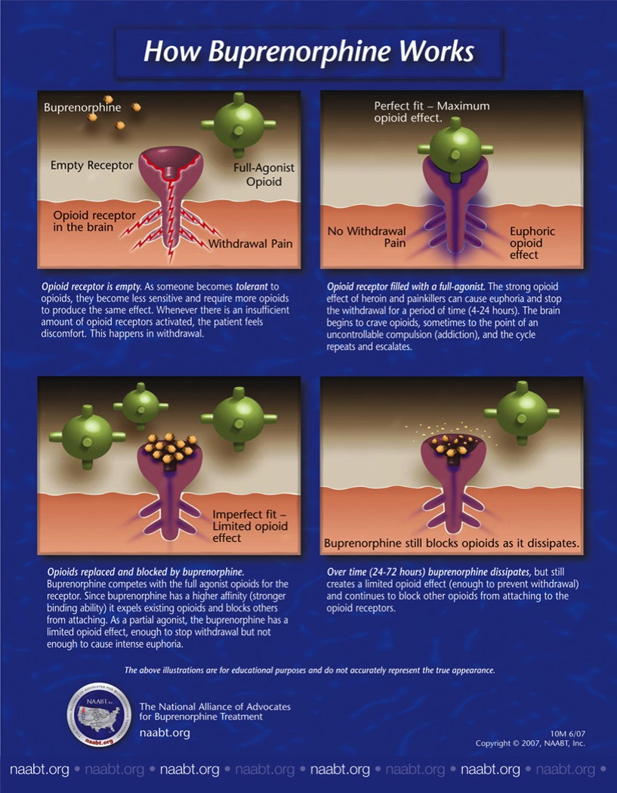

Slide 11
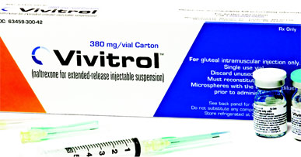
Injectable Naltrexone/Vivitrol-an antagonist
The active ingredient in Vivitrol, naltrexone, is an opioid antagonist or blocker. It attaches to the opioid receptors but doesn’t trigger the brain’s pleasure response
Vivitrol blocks the pleasurable feelings or “high” caused by using opioid drugs

Slide 12
VIVITROL along with counseling may help with alcohol and opioid dependence
Anyone who receives a VIVITROL injection must not use any type of opioid (must be opioid-free) for at least 7 to 14 days before starting VIVITROL.

Slide 13
ONCE-MONTHLY
VIVITROL’s long-acting formula means the injection only has to be administered once a month.
NON-ADDICTIVE
VIVITROL doesn’t lead to physical dependence.

Slide 14
Which medication should a patient choose?
Treatment should be individualized and tailored to the patient’s needs and desires with physician guidance and input.
Clinicians should consider the patient’s preferences, past treatment history, and treatment setting when deciding between the use of methadone, buprenorphine, and Vivitrol.
Clinicians should consider a patient’s psychosocial stressors and need for support, co-occurring disorders, and risk of diversion when determining whether OTP or OBOT is most appropriate.

Slide 15
The Steps for
Integrating New Medications into an OTP

Slide 16
Why don’t all OTPs offer all three medications?
OTP’s are highly regulated and must comply with many federal, state and city regulations.
Considerations when adding an additional medication to an OTP program:
  Policy and Procedures must be evaluated
  Training must be provided
  A contract with a pharmaceutical company to purchase the medication must be developed and signed
  Billing systems must be updated
  Electronic Records must be modified

Slide 17
Policy and Procedure
Before introducing a new medication, all policies should be reviewed and updated. Any place there is a mention of methadone, the additional medications must be mentioned and the policy updated and in some cases new policies may be needed (e.g., for storage of the medication, how to handle a buprenorphine patient who needs to be re-inducted, how to handle a patient who misses a naltrexone injection and relapses).
Procedures for storing, administering and monitoring the medication must be reviewed and updated.
Procedures for managing payment for the medication must be reviewed and changed as necessary. As buprenorphine and injectable naltrexone are more expensive, providers may want to develop a contract with the patient so that they understand, up front, what their costs will be if they lose insurance coverage and what their options will be in that case.
Also providers may want to put special monitoring systems in place to alert them if patients on buprenorphine or injectable naltrexone lose coverage

Slide 18
Training
Grand Rounds presentation for all staff
For buprenorphine, there is a specialized 8 hour training and waiver that must be obtained from the DEA for all physicians
For injectable naltrexone, the Provider’s Clinical Support System (PCSS- MAT) has excellent training videos to teach providers about the medication and how to deliver the injection
Physicians can provide training for the mid-level providers (PAs, NPs) and for nursing staff who will be observing ingestion of buprenorphine or who will be giving injections
It is helpful for staff to visit 1-2 OTPs that are already dispensing these medications
Ongoing discussions in weekly meetings to discuss patient progress and to determine if adjustments are needed to policy or procedure

Slide 19
Contracting & Billing for Buprenorphine
First, a decision has to be made whether to use the film or pill formulation of the medication and a contract has to be put in place to purchase the medication.
Programs bill Medicaid for Buprenorphine dispensed to each patient in an OASAS OTP by including the billing code J0592 on the weekly claim with the number of units of medication dispensed (each unit equals 8 mgs) and the procedure code for buprenorphine medication administration. The reimbursement for the J0592 is $7.01/8 mg strip⁽¹⁾ (with a maximum of 32mg [4 strips] per day). The maximum reimbursement per week for J0592 is $196.28 ($7.01 * 4strips * 7 days).
For services and medication costs billed through the APG methodology the program will submit a bill for each week and the claim should include:
At least one H0033 with the KP modifier appending to the first weekly administration provided during the weekly episode.
At least one J0592. The J0592 code should be included on a separate line for each Date of Service (DOS) in which the drug was provided with the corresponding number of units of medication dispensed.
The provider must include the NDC code on all drug code lines.
Additionally, the provider should include any other procedures and/or services.

Slide 20
Contracting and Billing for Injectable Naltrexone
Managed Medicaid - This is a plan covered medication. The claim is submitted to the plan and covered as part of the medical benefit. The medication is a plan covered benefit, but the programs must receive prior approval and will be reimbursed a contracted rate. A second claim is submitted to FFS Medicaid for the injection administration.
FFS Medicaid - The program must submit two Medicaid claims: Claim One: For medication administration use the appropriate CPT code (96372) and the J code (J2315 Injection). Providers must include the NDC number on the same line as the HCPCS drug code on the claim. Claim Two: All other procedures rendered during the visit should be billed through APGs.

Slide 21
Billing Systems
Before getting started, make sure your billing system is capable of handling these claims or that your billing vendor is aware of all OASAS billing guidelines and that they are comfortable billing for both the medication and the medication administration. Make sure you have the flexibility to update the NDC code any time you make changes to the company you purchase your medications from.

Slide 22
Electronic Health Record
Make sure your EHR can accommodate more than one medication and can track the inventory correctly.
Make sure the EHR captures the charges correctly and translates them properly to a bill.
You may want to develop an additional electronic templates to ensure your providers are documenting administration of the injectable naltrexone.

Slide 23
PCSS-MAT Mentoring Program
PCSS-MAT provides ongoing mentoring programs aimed at improving providers confidence in treating opioid use disorder. The PCSS-MAT program is designed to assist providers in incorporating the use of medications for prescription opioid addicted patients in their practices. The mentoring program is available, at no cost to providers. PCSS-MAT mentors are a national network of trained providers with expertise in medication-assisted treatment and skilled in clinical education. Mentors provide support by telephone, email, or in person if logistically possible.
http://pcssmat.org/mentoring/request-a-mentor

Slide 24
Thank you!!

