Slide 1


ASAP Annual Conference
October 12, 2015
Using Perception of Care Surveys to Demonstrate
Improved Quality and Outcomes
within Treatment and Recovery Programs
Susan Brandau – Susan.Brandau@oasas.ny.gov
Robert J Gallati – Bob.Gallati@arc-associates.net

Slide 2
TOPICS
Perception of Care Surveys – Tools for Quality Improvement
Substance Abuse Perception of Care Survey (SA-PoC)
Interpreting Sample Results from the PoC Pilot
Provider Adoption-Moving to Scale
Live Demonstration of PoC System
Developing Infrastructure for Quality Improvement (QI) using Perception of Care Surveys

Slide 3
A. Perception of Care Surveys -
Tools for Quality Improvement
  Institute of Medicine Recommendations
  Responding to the Health Care and Regulatory Environment

Slide 4
Institute of Medicine (IOM)
Recommendations (2006)
  Patient-centered Care
  Infrastructure for EBPs and QI
  Coordinate Care (SU, MH, Health)
  Health Information Infrastructure
  Workforce Capacity for QI
  Market Incentives Leverage Change
  Close Knowledge Gaps

Slide 5
IOM Recommendations
Patient-centered Care
  Involve patients and their families in the design, administration, and delivery of treatment and recovery services
Infrastructure for EBPs and QI
  Measure the processes and outcomes of care to continuously improve the quality

Slide 6
Conducting Perception of Care Surveys is responsive to:
  IOM Recommendations
  Accreditation Requirements
  Health Care Reform –PoC well suited to assess a dimension of prime importance in current health care: is a program and system of care oriented to consumers’ needs and values
  OASAS QI Regulations

Slide 7
B. Substance Abuse Perception of Care Survey (SA-PoCS)
  Development of Survey Questionnaire
  Survey Validity
  Content of Questionnaire

Slide 8
Development of Survey Questionnaire
SAMHSA-sponsored Modular Survey
Forum on Performance Measures for Behavioral Health and Related Services Systems
Different Populations: Mental Health, Substance Abuse, Adults, Adolescents
Different items for different populations, but common core items– thus “modular”

Slide 9
Limitations of Many
Client Satisfaction Surveys
Lack of Standardized Questions and Performance Dimensions
Result in High Levels of Satisfaction – No Room for Improvement
Lack of Psychometric Testing – Reliability and Validity

Slide 10
SAMHSA-sponsored Modular Survey
Based on content of
  MHSIP Consumer Survey
  ECHO Outcome Survey
  Youth Services Survey (YSS/YSSF)
Select the best questionnaire items using Item Response Theory (IRT)

Slide 11
  Survey Validity
Psychometric Assessment of
SAMHSA Modular Survey
New York’s Perception of Care Survey
  Nathan Kline Institute (NKI)
  CSAT Technical Assistance Grant to OASAS
  Verify items, and survey as a whole with its 4-point IRT response scale, are reliable for OASAS clients
  Foundation for future validation studies re PoC measures relative to independent measures of quality and outcomes to meet NQF performance measures

Slide 12
PoC and National Standards of Care
NKI Summary Findings
PoC survey provides superior standard for comparison of programs against national benchmarks, ACA and NQF
PoC surpasses 11 of the ACA health-quality measures that are directed at MH and SUD services and that highlight client satisfaction

Slide 13
PoC Meets NQF Endorsement Criteria
Emphasis on importance of client-centered measurement and reporting
Scientifically validated psychometric properties
User-friendly data retrieval capacity
Benefit to users-consumers, purchasers, providers, policymakers and accreditation entities

Slide 14
New York’s Adaptation of the
SAHMSA-sponsored Modular Survey
5 Domains : Rating Scales
  A. Access and Quality (7 items)
  B. Perceived Outcome (6 items)
  C. Social Connectedness (7 items)
  D. Readiness for Change (2 items)
  E. Program Recommendation (2 items)
Open-ended Items (write-ins)
  What is the program doing right?
  What can be done to improve the program?
  Is there anything that annoys you?

Slide 15
Content of Survey (Continued)
Best Practices
  Patients Rights
  Nicotine Replacement Therapy
  Medication Supported Recovery
Other Items
  Time in Program (months)
  Age, Gender, Ethnicity/Race
  Presenting Problem (SA, MH, both)
  Prior Treatment
  Criminal Justice Mandate
  Employment/School Enrollment Status

Slide 16
Rating Scale
Disagree | Somewhat Agree | Agree | Strongly Agree
□ | □ | □ | □
“Not Applicable” or “Don’t Know” is not an option.
However, if an item is left blank, it is coded as “No Response.”

Slide 17
C. Interpreting Sample Results from the PoC Pilot

Slide 18
A: Access and Quality
1. When I needed services right away, I was able to see someone as soon as I wanted.
2. This program helped me develop a plan for when I feel stressed, anxious or unsafe
3. The people I went to for services spent enough time with me.
4. I helped to develop my service/treatment goals.
5. The people I went to for services were sensitive to my cultural background (race, religion, language, sexual orientation).
6. I was given information about different services that were available to me.
7. I was given enough information to effectively handle my problems.

Slide 19
Exercise
I helped to develop my service/ treatment goals.
Imagine one of your programs.
Out of 80 clients…
How many do you think would rate their program in each category?
Disagree | Somewhat Agree | Agree | Strongly Agree
20? | 20? | 20? | 20?

Slide 20
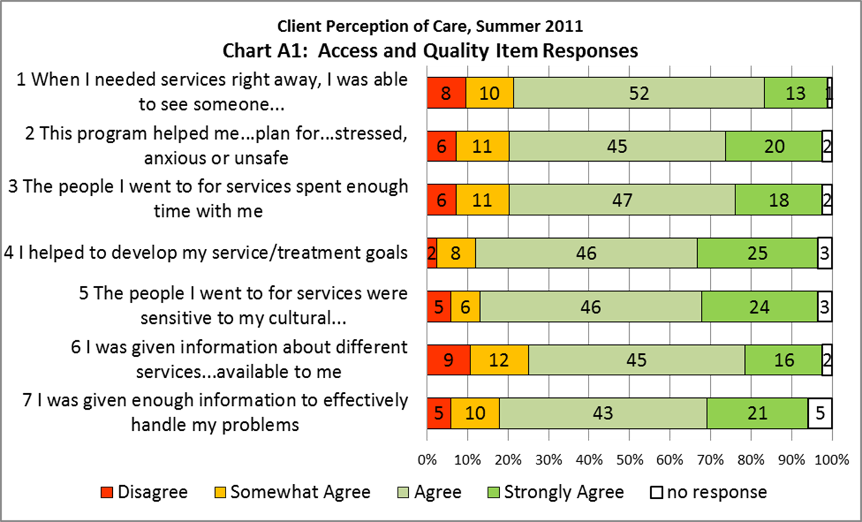

Slide 21
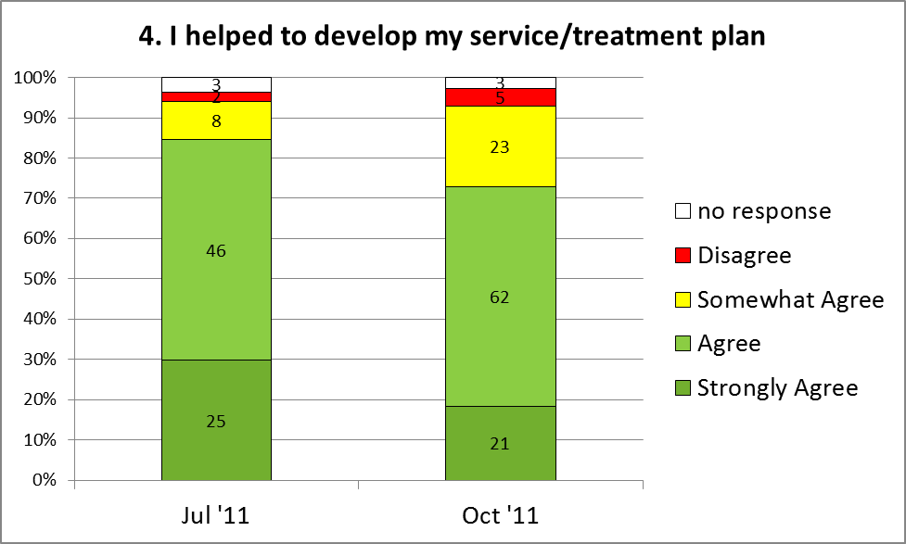
Hypothetical Change Over 3 months
(Note different sample sizes)

Slide 22
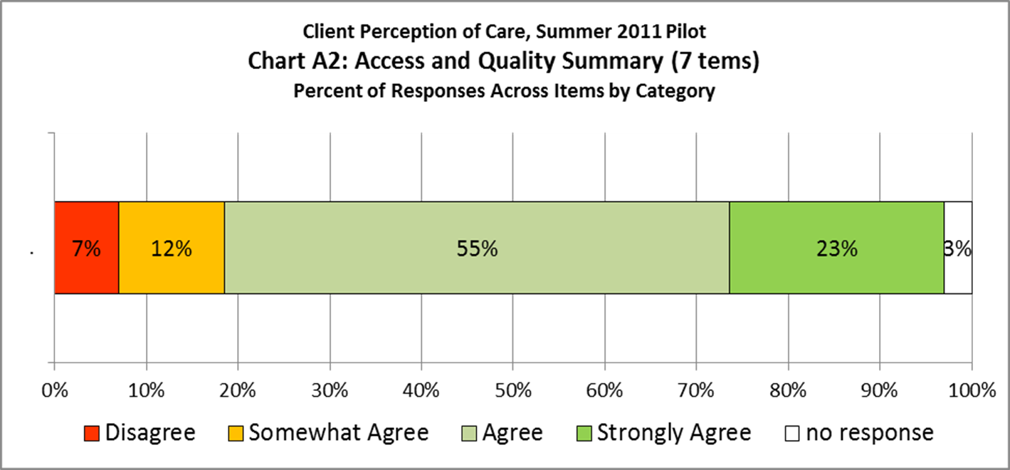

Slide 23
B: Perceived Outcome
As a result of the services (treatment) I have received ...
8. I am less bothered by my symptoms
9. I am better able to cope when things go wrong.
10. I am better able to accomplish the things I want to do.
11. I am not likely to use alcohol and/or other drugs.
12. I am doing better at work/school. (If this does not apply to you, please leave it blank.)
13. I get along with my teachers/boss. (If this does not apply to you, please leave it blank.)

Slide 24
Exercise
As a result of the services (treatment) I have received…
11. I am not likely to use alcohol and/or other drugs.
Imagine one of your programs.
Out of 80 clients…
How many do you think would rate their program in each category?
Disagree | Somewhat Agree | Agree | Strongly Agree
20? | 20? | 20? | 20?

Slide 25
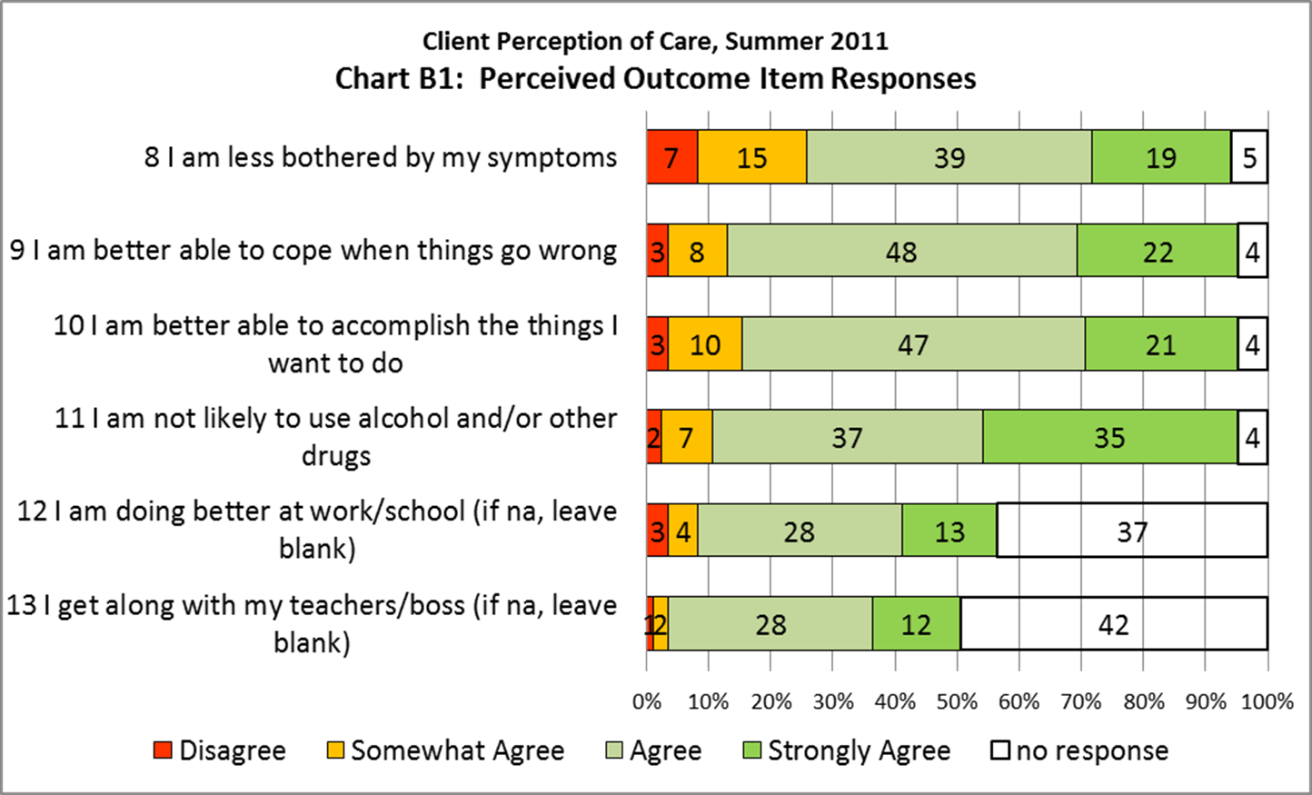

Slide 26
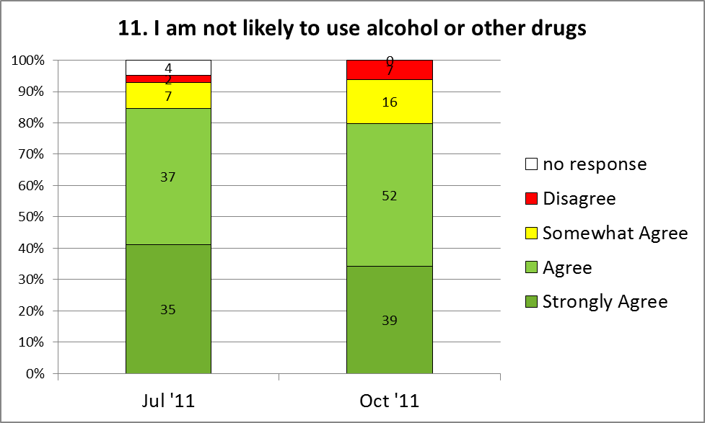
Hypothetical Change Over 3 months
(Note different sample sizes)

Slide 27
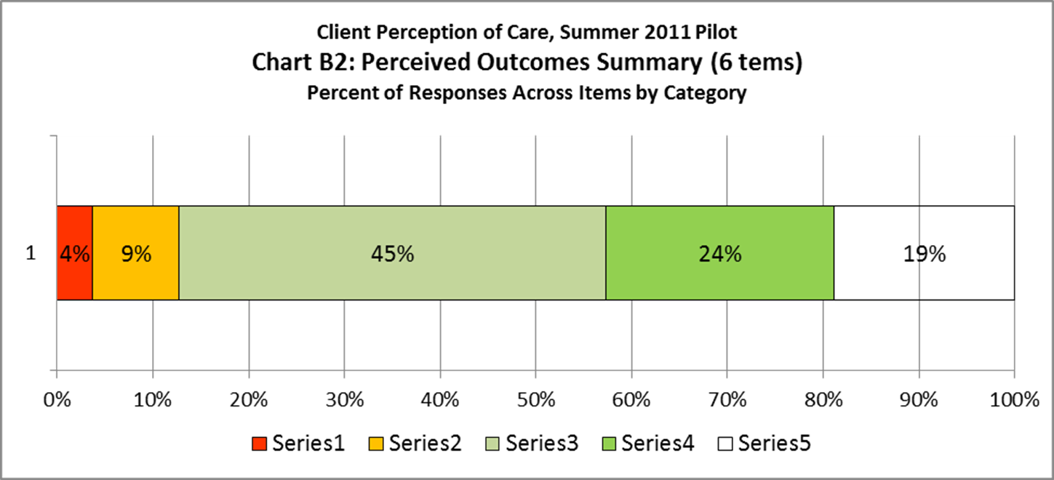

Slide 28
C: Social Connectedness
14. There is someone who cares about whether I am doing better.
15. I have someone who will help when I have a problem.
16. I have people in my life who are a positive influence.
17. The people I care about are supportive of my recovery.
18. People count on me to help them when they have a problem.
19. I have friends who are clean and sober.
20. I have someone who will listen to me when I need to talk.

Slide 29
Exercise
19. I have friends who are clean and sober.
Imagine one of your programs.
Out of 80 clients…
How many do you think would rate their program in each category?
Disagree | Somewhat Agree | Agree | Strongly Agree
20? | 20? | 20? | 20?

Slide 30
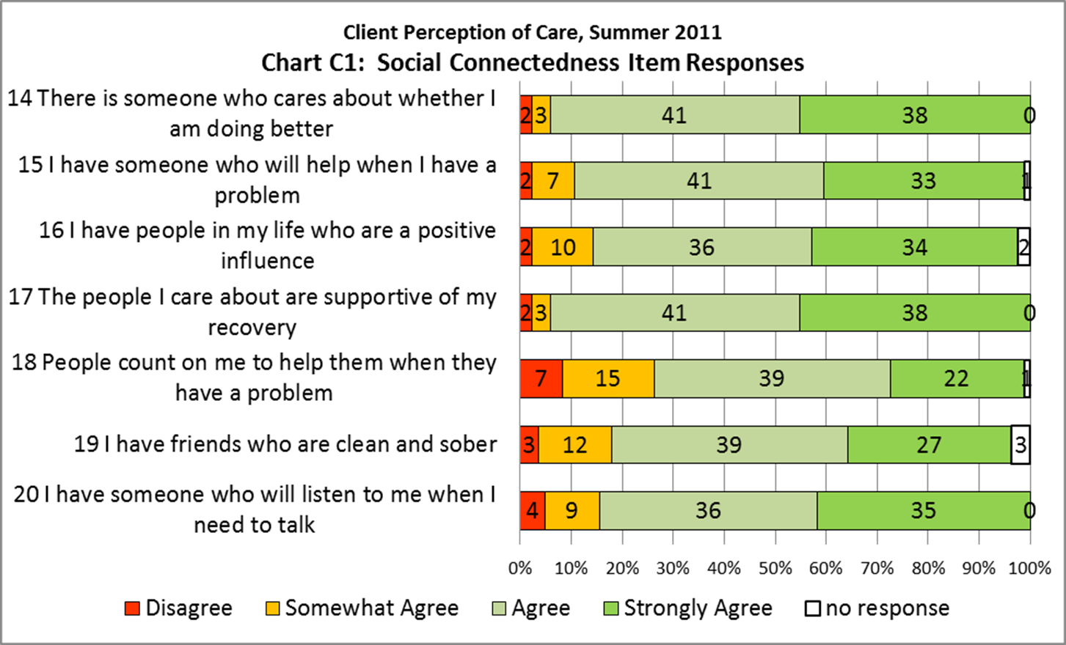

Slide 31
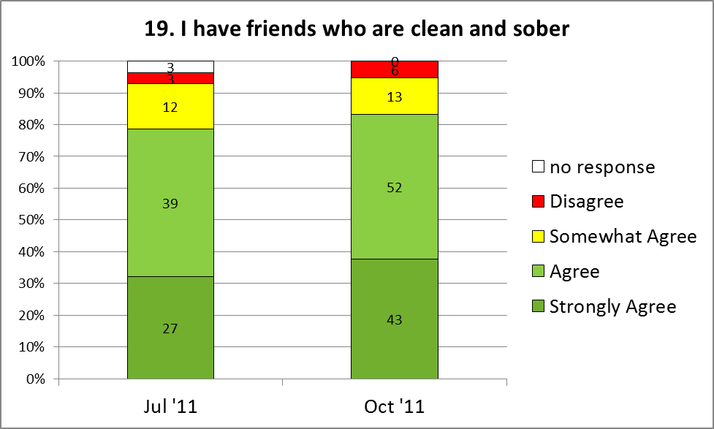
Hypothetical Change Over 3 months
(Note different sample sizes)

Slide 32
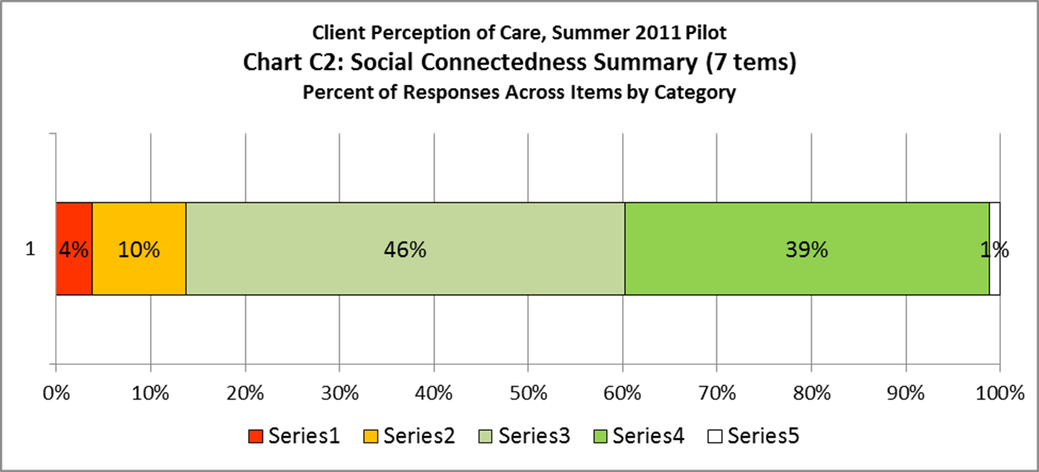

Slide 33
D: Readiness for Change
Using alcohol and/or drugs is a problem for me.
22. I need to work on my problems with alcohol and/or drugs.

Slide 34
Exercise
22. I need to work on my problems with alcohol and/or drugs.
Imagine one of your programs.
Out of 80 clients…
How many do you think would rate their program in each category?
Disagree | Somewhat Agree | Agree | Strongly Agree
20? | 20? | 20? | 20?

Slide 35
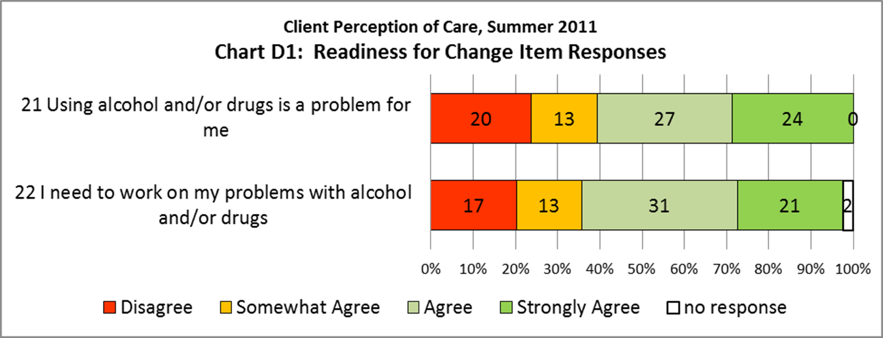

Slide 36
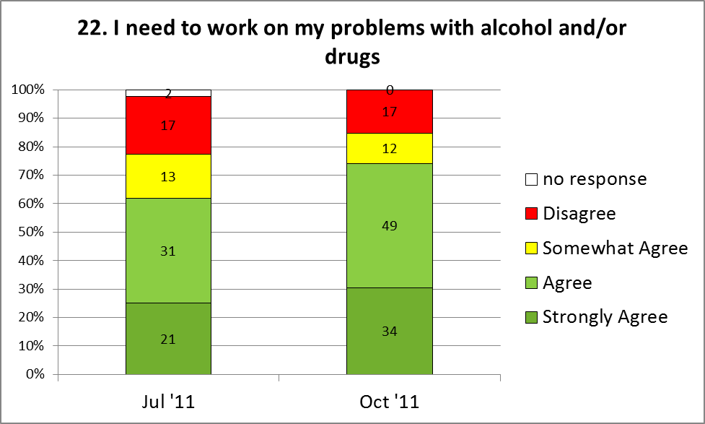
Hypothetical Change Over 3 months
(Note different sample sizes)

Slide 37
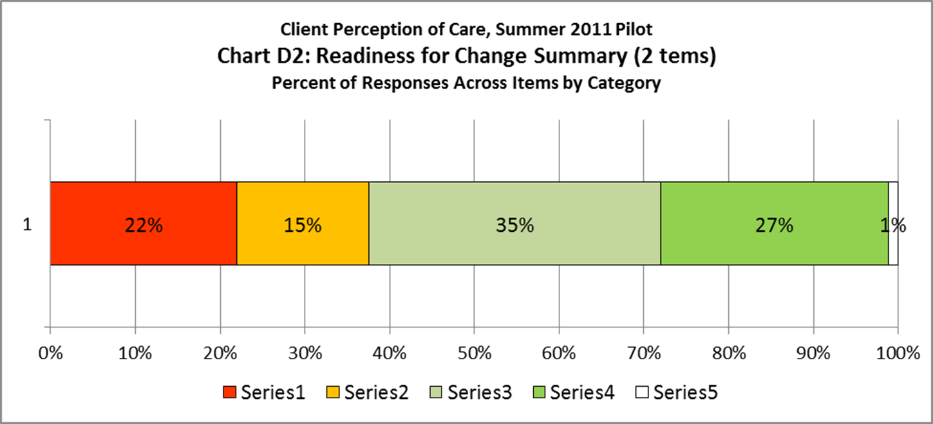

Slide 38
E: Program Recommendation
(Satisfaction)
I would return to this program if I need help in the future
24. I would recommend this program to a friend or family member.

Slide 39
Exercise
24. I would recommend this program to a friend or family member.
Imagine one of your programs.
Out of 80 clients…
How many do you think would rate their program in each category?
Disagree | Somewhat Agree | Agree | Strongly Agree
20? | 20? | 20? | 20?

Slide 40
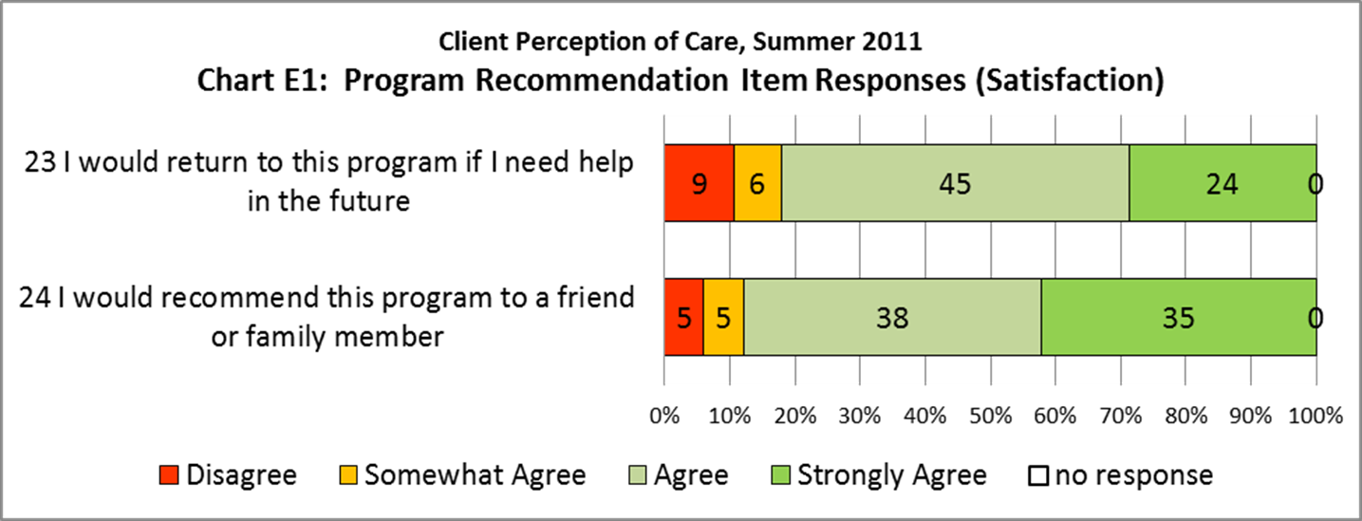

Slide 41
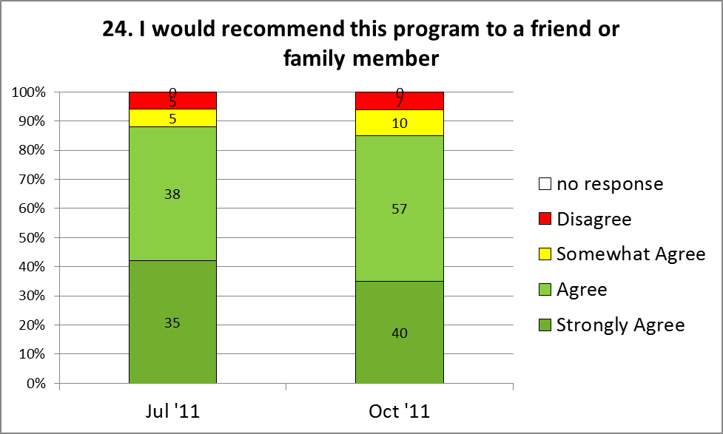
Hypothetical Change Over 3 months
(Note different sample sizes)

Slide 42
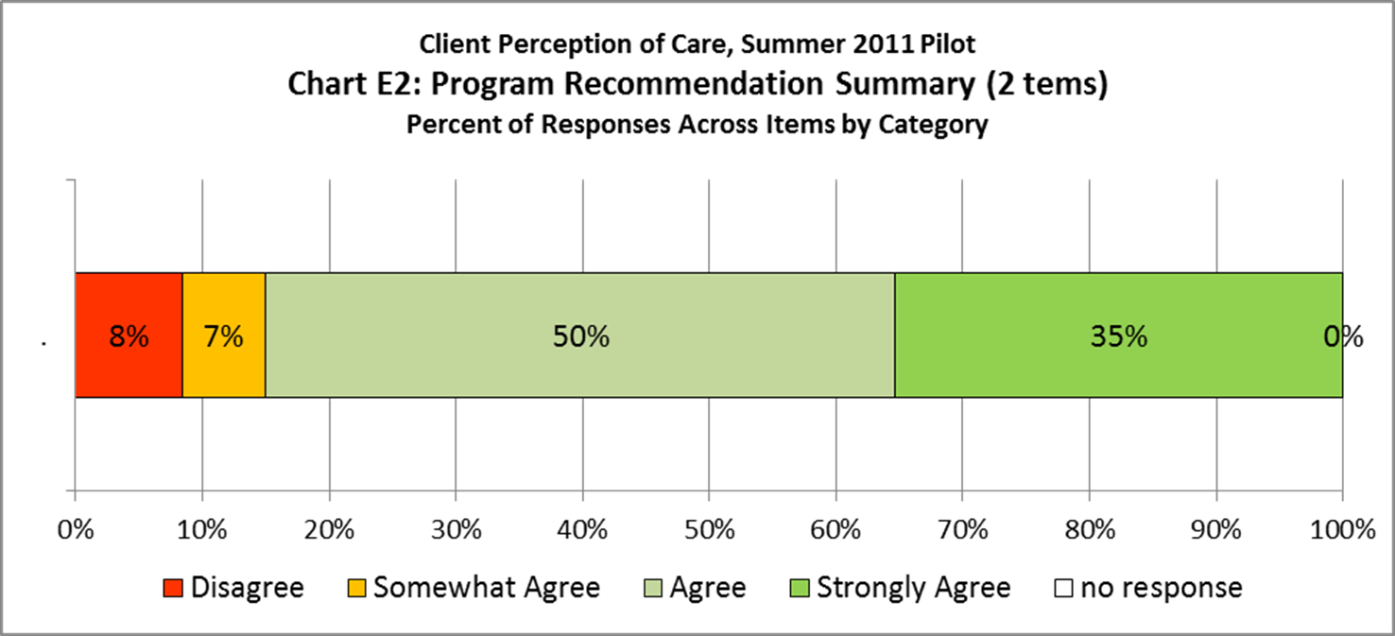

Slide 43
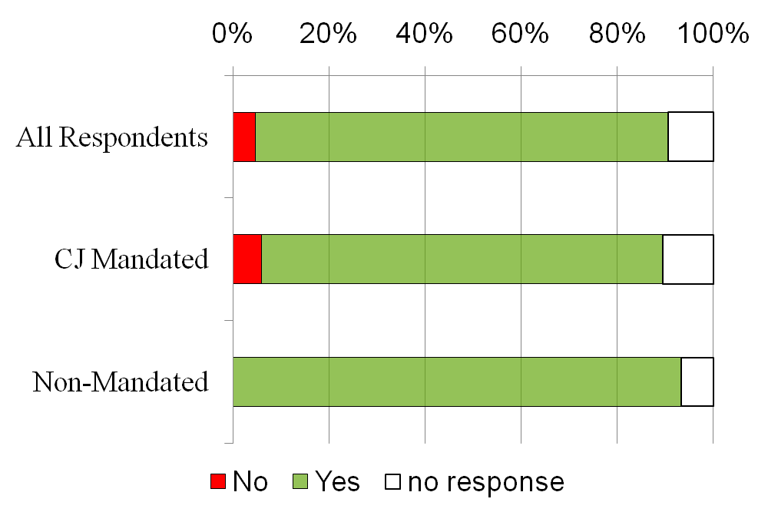
When you came for services, were you given information about your rights as a client?

Slide 44
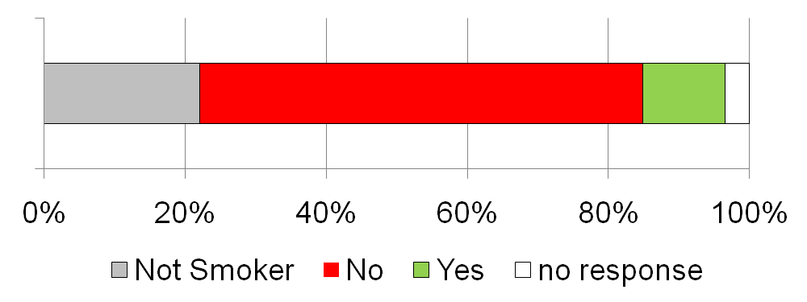
Did this program offer you nicotine replacement therapy (such as a patch, lozenge or gum) if you were a smoker?

Slide 45
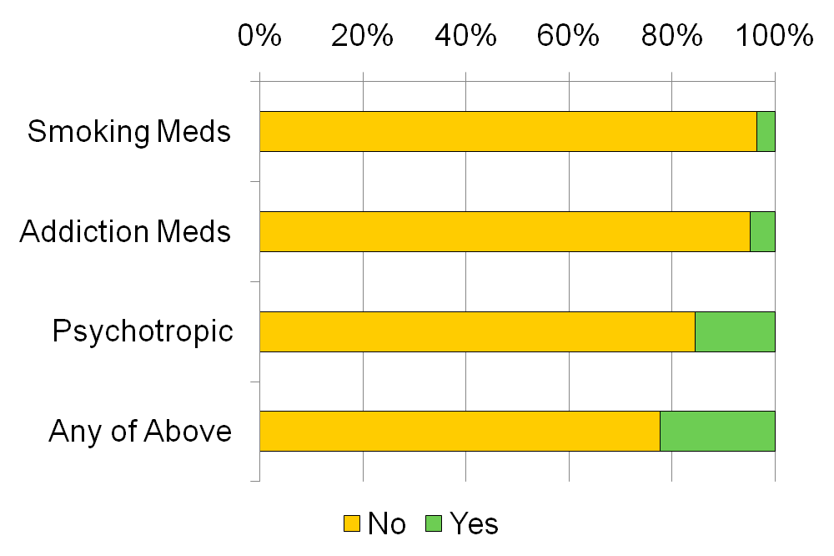
Did someone from this program (a doctor, nurse, counselor, or therapist) recommend a prescription medication? (Check all that apply.)

Slide 46
D. Provider Adoption – Moving to Scale
  Trend in Program Participation
  Types of Programs Participating
  Regions of Participating Programs

Slide 47
Trend in Program Participation
“Program Participation in a Calendar Quarter” means that 5 or more completed surveys were entered into the POC Survey System for the calendar quarter. (Five respondents is a practical limit for generating any program statistics.)
Program participation increased each quarter (except in the 3rd quarter 2014) reaching 99 participating programs in the 2nd quarter 2015.
About 10% of all programs are participating in the POC Survey System. Participation is voluntary.

Slide 49
Types of Programs Participating
Of the 99 programs participating in Spring 2015:
2 programs were outpatient opiate treatment program (OTP), formerly methadone maintenance programs.
60 were other outpatient programs, including clinic, outpatient rehab, specialty traumatic brain injury (TBI) programs.
27 residential programs participated; these included intensive residential, community residence and supportive living programs.
7 inpatient rehab treatment programs participated, including 4 of the 12 OASAS-operated programs.
2 crisis services programs participated

Slide 51
Regions of Participating Programs
Programs across all 7 OASAS regions participated in the POC Survey System
The greatest number of programs participating were in the Northeast region (24), followed by Western NY (21) and the Mid-Hudson (17).
Regions poorly represented were: New York City (16), Long Island (5) and the Finger Lakes (3).

Slide 53
E. Live Demonstration of PoC System

Slide 54
F. Developing Infrastructure for Quality Improvement (QI) using Perception of Care Surveys
    Computer Technology
    Survey Methods
    Quality Improvement Methods
    How can OASAS facilitate effective use of Perception of Care Surveys to improve the quality of treatment?

Slide 55
Infrastructure: Survey Methods
  Standard Instrument
    Quantitative Measures
    Open-ended and Qualitative
  Standard Protocols and Procedures
    Who administers survey?
    Who completes survey?
    When in the course of treatment?
    How often? Ongoing? Quarterly?
    Anonymous or linked to client?

Slide 56
Infrastructure: QI Methods
  Who reviews clients’ responses? When?
    QI/QA Team or Change Team
    Open-ended items
    QI Reports
    Feedback loops to Staff & Clients
  Benchmarks
    Across programs, statewide, provider
    Within program over time
  PDSA Cycle – Plan…Do…Study…Act

Slide 57
Five Key Principles
Evidence-based predictors of change
Understand & Involve the Customer
Focus on Key Problems
Select the Right Change Agent
Seek Ideas from Outside the Field and Outside Your Organization
Do Rapid-Cycle Testing
Notes:
57

Slide 58
Understand and Involve the Customer
Most important of all the Principles
What is it like to be a Customer? Staff are customers, too!
Walk-through, focus groups, perception of care surveys…

Slide 59
Select a Dynamic
Change Team Leader
A person who has:
influence, respect and authority across all levels of the organization
a direct line to the People who can authorize change
empathy and respect for the staff
time available to lead change projects
no fear of data

Slide 60
Do Rapid-Cycle Testing
Start by asking questions:
What are we trying to accomplish? What did our perception of care survey data tell us?
How will we know the change is an improvement? Will we re-administer the survey or look at other data sources, such as retention measures?
What small changes can we test that will result in an improvement? Have we asked the clients or customers for improvement ideas?
  Langley, Nolan, Nolan, Norman, & Provost. The Improvement Guide, San Francisco, Jossey-Bass Publishers, 1996
Notes:
60
The 4th & 5th principles, Seeking change ideas outside the organization and Do Rapid-Cycle testing, are address thru the PDSA Process Improvement model.
Ask three fundamental questions:
1. What are we trying to accomplish?
2. How will we know if a change is an improvement?
3. What changes can we test that may result in an improvement?
This is where we engage in idea generation - use the Nominal Group technique, looking at customer suggestions, try looking outside the agency for ideas, etc.
And once a promising change has been identified, rapidly use the Plan-Do-Study-Act (PDSA) cycle to turn a change idea into action:

Slide 61

Rapid-Cycle Testing
Rapid-Cycle changes
  Are quick; do-able in 2 - 4 weeks
PDSA cycles
  Plan the change
    Do the plan
      Study the results
        Act on the new knowledge
Notes:
61
In closing of this portion of the presentation, we want to reiterate:
Use the PDSA process to:
pilot test changes
implement further changes – spreading a change from one location or level to another, merge step into the whole process, etc.
sustain changes

Slide 62
Plan
Define the change behaviorally… precisely what will be done in response to the survey data?
Who will implement the change?
What preparation needs to be done before starting the change?
Clarify who will measure the change and who will review the data regularly to share with the team.

Slide 63
Do
Note the start date for the cycle
How long will the initial test last?
How often will the team meet to assess progress and review data?
During the test, the team makes ONE change to be made to improve the results

Slide 64
Study
After the agreed upon test period the team reviews the results, shares with other staff for feedback
Change leader / Data Coordinator assembles and graphs the data for the Change Team, if needed
The Change Team deliberates what it has learned
Share results with clients for feedback, ideas, improvement opportunities

Slide 65
Act
In light of what has been learned, the team decides what to do next
  The data is not moving in the direction you predicted? Terminate the existing strategy and start a new cycle
  Make an adjustment in the strategy to get closer to the objective
  Increase the objective if the initial target has been met and the team believes even more progress can be made
  Implement the winning change as policy

Slide 66
Act on the Data & Lessons Learned
The 3 A’s | Applicable Situation | Course of Action:
Abandon the Change | The Change Process did not achieve the desired goal, | Discontinue the change. Consider other change options appreciate lessons learned
 | (no/negative progress)
Adopt the Change | The Change Process achieved the desired goal. | Move to Sustaining the change Celebrate the Results
Adapt The Change | The Change Process partially achieve the desired goal | Engage in another change cycle, by Making One Different Change
Notes:
There are three possible courses of action that can be taken by the Change Team following their study of the data. These “3 A’s” are described in this graphic.
A lack of desired change is not a failure.
Sometimes change exercises do not achieve the desired results, or may even result in outcomes that are “worse” than the baseline measurement. This can be caused by a misinterpretation of known variables, or by previously unrecognized variables that have influenced the process. While changes with such results will usually be abandoned, it is important to view them as learning opportunities, and not as failures. Such changes push a team to reconsider the big picture, and to recognize factors that may have been under estimated, or invisible, in the planning of the change.
When a team understands that a particular change effort it not useful to their service they are armed with valuable information. They now know that they should not dedicate any future resources to that approach. A “failed” change may result in tremendous long term savings through the avoidance of wasted effort, and may direct the team toward a different path that will have the desired impact. For example, some Change Teams have found that reminder calls have had no impact on the show rate for intake sessions. This is sometimes due to the fact that the client population is highly transient, with frequently changing addresses and phone numbers, and is difficult to contact by phone. Understanding of this transiency can lead the Change Team toward more successful outreach strategies.
TIP: Celebrate the results
Regardless of the results of the change, it is important to celebrate the team’s efforts. Recognition of the progress achieved, and/or the lessons learned will motivate the team as it considers its next steps forward on this improvement journey. Celebration is also an excellent way to engage new team members and to spread the awareness of the Rapid Cycle PDSA change model to other staff members. Consider all of the benefits that are worth celebrating, including increased revenue, ease of work burden on staff, and improved customer satisfaction. It is particularly important to tie the progress of a change back to the broader goal and service mission. Sometimes busy staff can forget to look for the forest through the trees. A celebration can remind them that the change is working to help the lives of the people they serve.
See Step 7 in the Manual.
66

Slide 67
QI Infrastructure and
Perception of Care Surveys
    How can OASAS facilitate the effective use of Perception of Care Surveys to enhance patient-centered care, promote continuous quality improvement and improve treatment outcomes?
    We Want to hear from YOU!!

Slide 68
Contact Information
Susan Brandau, (518)485-2107
  Susan.Brandau@oasas.ny.gov
Bob Gallati, (518) 526-5953
Bob.Gallati@arc-associates.net

