Slide 1
Engagement Strategies in Clinical Settings:
A review of effective behavioral techniques to engage and activate clients in treatment
David Loveland, PhD

Slide 2


Challenges of Changing Behavior
What does the trey of freshly baked chocolate chip cookies on the left have in common with the bowl of radishes on the right?
Notes:
What does the tray of hot, homemade chocolate chips cookies on the left have in common with the bowl of cold radishes on the right?

Slide 3
Challenges of Changing Behavior
The cookies and radishes displayed in the prior slide have been used repeatedly in an experiment to examine the powerful impact of ego depletion,
  Ego depletion is the loss of mental energy and a subsequent reduction in capacity to avoid urges or persevere on challenging tasks
  The research is summarized in Baumeister, R.R. & Tierney, J. (2011). Willpower. New York: Penquin Press

Slide 4
Challenges of Changing Behavior
Participants are separated in to two groups & asked to sit at a table for 10 minutes before the experiment begins
  the participants are unaware that waiting in the room is the experiment
  At the table is a trey of freshly baked chocolate chip cookies that were pulled out of the oven as the participants sit down
  The table also has a bowl of radishes
Participants in one group are told to help themselves to the cookies or radishes while those in the other group are asked to avoid the cookies, but they can eat the radishes if they get hungry while waiting

Slide 5
Challenges of Changing Behavior
Participants are combined again after 10 minutes of waiting in separate rooms and asked to complete one of two tests of endurance that is timed
  Place one hand and lower arm in a tank of ice water or
  Work on a puzzle that cannot be solved
    the participants don’t know that it can’t be solved, so they are timed on how long they try before giving up
One of the groups always outperforms the other group; in other words, one group, on average, can last 30% longer in the ice water or work on the puzzle – which group does better and why?

Slide 6
Ego Depletion and Decision Fatigue
  Decision fatigue or ego depletion is a likely barrier to people making changes that they want to make
  Everyone has the same amount of mental fuel to think; however, people can drain their mental fuel faster when they are stressed, overwhelmed, or dealing with a chronic physical or behavioral health condition
  Decision fatigue is the inability to make even simple decisions

Slide 7
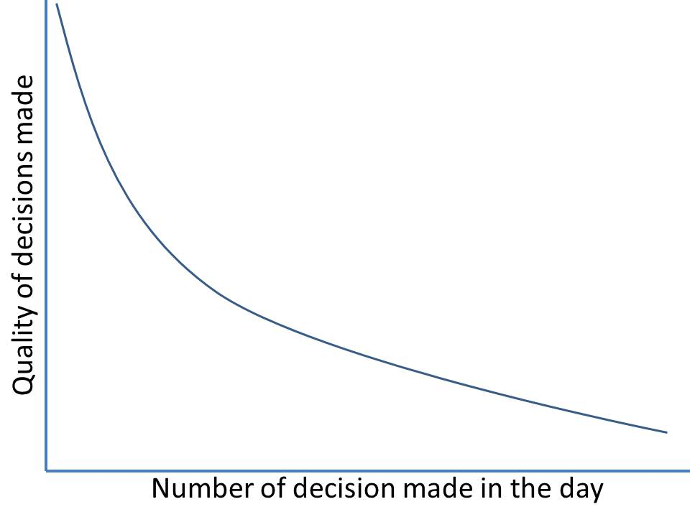
Ego Depletion and Decision Fatigue
While fatigued, people are unable to pull up new information that requires more energy/fuel to find
It takes minimal energy to recall existing behaviors
Decision fatigue/ego depletion leads people to selecting established habits, even bad ones (e.g., eating junk food), because they can be initiated without thought

Slide 8
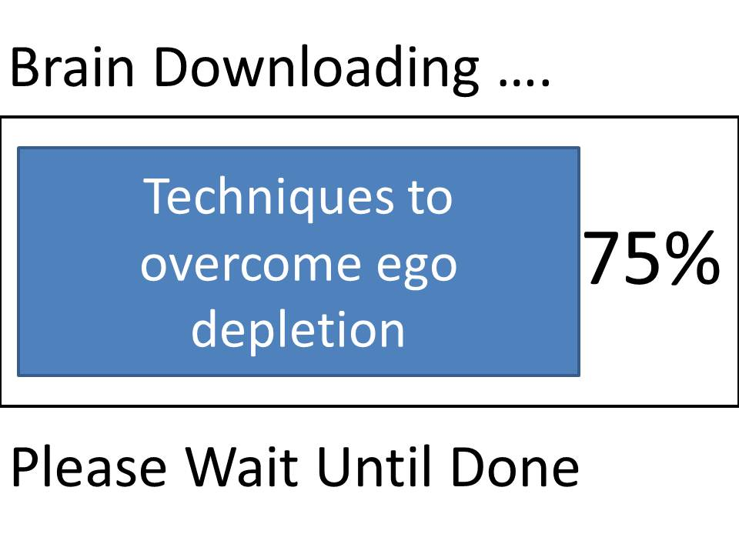
Ego Depletion and Decision Fatigue
Preloading the brain with a detailed plan can effectively combat decision fatigue while increasing the person’s sense of confidence and abilities
Preloading a plan involves clearly outlining the what, how, when, where & with whom the plan will occur
People load the plan in advance & under calm emotions, usually within 1 to 7 days of the activity
Action Plan
What | When | Where | Who
Take 1 lipitor pill in the morning | Tomorrow after you eat an egg | Place the pills next two the fridge | Tom will send you a text reminder

Slide 9


Techniques to Overcome Ego Depletion
How do you get someone from here to here?

Slide 10
Techniques to Overcome Ego Depletion
The following 4 studies highlight the potential impact of helping people achieve their self-directed goals as well as showing that motivation alone will not achieve a goal, but that simple instructions can increase the likelihood that people can achieve their goals
The research also reveals that people can improve performance on a goal that they want to achieve with a simple step that requires no more than 5 minutes to administer

Slide 11
Techniques to Overcome Ego Depletion
College students volunteered to participate in a study to increase their cardio exercising on a weekly basis (Milne, Orbell & Sheeran, 2002)
Students were randomly assigned to one of three groups, with all three groups being tracked for 21 days (3 weeks)
  Each group met with the research team on first day of each week to complete data collection & receive education
Students were asked to initiate one or more episodes of cardio exercise each week – defined as 20 minutes or more of intensive exercise that raised their heart rate
  Students selected exercise they wanted to initiate

Slide 12
Techniques to Overcome Ego Depletion
The bar graphs on the following slide displays the common pattern seen in New Year’s Resolutions, in that students find it difficult to start exercising, and their ability declines steadily over 3 weeks
The last bar graph for 3rd group shows a significant increase in exercising in the 3rd week of the study
  nearly everyone in the group initiated one or more episodes of exercising
  what changed for the 3rd group in the 3rd week?

Slide 13
Completing At Least 1 Cardio Exercise

Slide 14
Techniques to Overcome Ego Depletion
Students in the 3rd group were asked to read the following statement at the start of the 3rd week:
  Many people find that they intend to take at least one 20-minute session of vigorous exercise but then forget or never get around to it. It has been found that if you form a definite plan of exactly when and where you will carry out an intended behavior you are more likely to actually do so and less likely to forget or you don’t get round to doing it. It would be useful for you to plan when and where you will exercise in the next week.

Slide 15
Techniques to Overcome Ego Depletion
Students in the 3rd group were then asked to complete the following statement:
  During next week I will partake in at least 20 minutes of vigorous exercise on (day or days) __________ at ___________(time of day) at/or in (place)___________
The instructions are known as preloading the brain with a plan
  The 3rd group went from 35% to 91% in exercising based on a 5-minute preloading exercise that helped them to plan for the activity
  The other two groups showed an expected decrease in exercising in the third week

Slide 16
Techniques to Overcome Ego Depletion
Another set of researchers wanted to know if the impact found in the study could be extended over several weeks and with a non-college sample
52 women enrolled in a weekly exercise program at a local health club agreed to participate in a randomized study to track the number of times they exercised at the gym each week for 11 weeks (Murray et al., 2009)
  The only difference between the two groups was a 5 minute instruction that the experimental group received at weeks 1, 2 & 6

Slide 17
# of Times People Exercise Each Week

Slide 18
Techniques to Overcome Ego Depletion
64 patients (average age = 68) undergoing hip or knee replacement surgery volunteered to participate in a study to improve post surgery functioning (Orbell & Sheeran, 2000)
Patients voluntarily selected one of two conditions for the study (not randomized) with one group accepting an additional step that they would follow during the rehabilitation phase
  Both groups received the same rehabilitation exercises, the same list of 32 activities/exercises that they were asked to complete in 13 weeks, and the same medical care
  The only difference was an instruction on how to plan for the week’s activities

Slide 19
Completing 13 Weeks of
Physical Rehabilitation

Slide 20
Techniques to Overcome Ego Depletion
Teenagers were asked to voluntarily participate in a high school health education study if they were actively drinking alcohol (Armitage et al., 2014)
  The teenagers were not asked to stop drinking nor were they screened for alcohol abuse issues
  They were assigned randomly to one of two “educational sessions about alcohol” with both groups receiving a health risk message about alcohol use from AUDIT manual
  The experimental group received a 5 minute intervention that required minimal instruction from the researchers

Slide 21
Teenagers Reducing Alcohol Consumption

Slide 22
Increase Engagement: CAN Steps
C
Change the pathway
Change the pathway to treatment instead of trying to change people
A
Activate people
Activate potential clients by focusing on their strengths, capabilities, and values
N
Nudge movement
Nudge people forward with one or two simple steps to create traction

Slide 23
      C
      change the pathway to treatment: make it easier for people to receive help, access treatment or resolve their crisis

Slide 24
Barriers to Change
Motivation may not be a barrier to change for people with behavioral health disorders; however, a person’s life stressors, existing demands, and established habits are likely barriers to change
Ego
Depletion
Point
A
Limited time
Decision fatigue
Established habits
Unrealistic plans
Point
B

Slide 25
Average Delay in Seeking Treatment

Slide 26
Barriers to Engaging in Treatment
Individuals who finally make the call to a behavioral health center have been suffering between 8 to 20 years, yet have more motivation than the majority of individuals who don’t make the call
In other words, those who make the call are unique and in the minority
The problem is that those who make the call have little energy left to give to the healing process and need help quickly to keep persevering

Slide 27
Barriers to Engaging in Treatment
Individuals seeking behavioral health treatment are usually required to navigate through multiple challenging steps & appointments before they can receive a therapeutic intervention
The enrollment process usually takes between 14 and 21 days (sometimes longer) between a person’s request for help and receiving help
Approximately 65% of individuals seeking help will disengage within the 9 steps outlined in the following slide because they cannot persevere through the steps to receive help

Slide 28
Conventional Enrollment Process
1. Person calls for help, some shame is experienced in making the call
2. Phone staff begins to ask questions about insurance & primary problem
3. Person receives an appointment, but no help, waits 1 to 7 days for appt
4. Person travels to office for appt & is asked to bring medical info
5. Person receives a 1 to 2 hour assessment focused on deficits
6. Person receives a DSM diagnosis, new appt, & travels back home
7. Person waits for first appointment for treatment, another 7 to 14 days
8. First appointment, redundant data are collected again,
9. Treatment plan is developed & treatment begins, 14 to 21 days after request for help

Slide 29
Ego Depletion and Decision Fatigue
  All 9 enrollment steps noted in the prior slide can increase ego depletion & decision fatigue by requiring people to
    persevere without help for several days or weeks,
    talk about their pain, misery and past mistakes,
    make multiple difficult decisions, and
    memorize extensive amounts of new information, such as
      Appointment times
      Locations of offices
      Bring medical records or prior medications
      Bring insurance information

Slide 30
Overcoming Ego Depletion & Decision Fatigue
  Ego depletion can be countered with activities that inspire hope & restore glucose to the brain; in other words, people can receive interventions that are ego strengthening
  Ego strengthening interventions can be provided within each step of the enrollment process to improve
    Memorization (e.g., remembering appointments),
    Perseverance (e.g., waiting for an appointment), or
    The ability to make effective decisions

Slide 31
Example – Julie
Julie is a single, 35 year old female who was referred to our research program after she left our agency’s residential addiction treatment program AMA
  She has left several residential & outpatient programs as well as mental health treatments AMA over the past 15 years
  She left the program on a Thursday and called our office the following Monday morning wanting help - treatment
Julie has several diagnoses for addiction as well as for PTSD, depression, anxiety and attention deficit disorder
  She has had a long history of being physically and sexually assaulted by family members and boyfriends, including the present one

Slide 32
Behavioral Principles for Engagement
Rule 1: the more decisions, options or goals that you have to select or set, the less likely you are to make the right choice or achieve your goal
  People are often frozen by ego depletion or decision fatigue
  People can also be undermined by selecting multiple options that may actually compete, contradict, or cancel out other goals
Step 1: select one or two small steps to focus on and mentally place other goals on hold for later
  Become good at achieving a goal to develop self efficacy

Slide 33
Example – Julie’s Tx Plan
Julie’s treatment plan from her residential program as well as her prior treatment plan from the mental health division of the agency consisted of multiple diagnoses, clinical goals and objectives/steps
Julie did not want to work on most of the objectives assigned to her and was easily overwhelmed by the size of the printed treatment plan, which exceeded six pages and included unrealistic timeframes for resolving long-standing behaviors

Slide 34
Behavioral Principles for Engagement
  Rule 2: All behavior is functional in the short-term, even if some behaviors are leading to negative outcomes in the long-term
    Our brains have evolved to organize all repetitive behaviors in to habits, which are automated actions that don’t require our conscious brain to activate
    All habits are difficult to stop because our brain does not separate good from bad & relies on all of them
  Step 2: Understand the function of habits or behaviors, before changing them
    Replace a habit or behavior to meet the function, instead of trying to stop a particular “bad” habit

Slide 35
Behavioral Principles for Engagement
Julie had developed a series of habits to manage her symptoms of PTSD and it appears that many of the tx interventions were triggering her habits for coping
Use cocaine, escape, or seek men to manage negative feelings
Negative reinforcement – reduce immediate emotional pain
People attempting to control her, not feeling in control, confusion, confrontation or waiting

Slide 36
Behavioral Principles for Engagement
  Rule 3: Most plans fail because of poor planning, not because of low motivation or desire to change
    Many individuals who are already on a losing streak are more likely to give up on an desired goal, if they feel that it is too difficult to achieve
    People are more likely to stay on track if they can experience small wins quickly and frequently
  Step 3: Teach thinking skills that increase the chance of winning
    Improve the chances of winning by increasing the person’s ability to effectively plan for success

Slide 37
Example – Engaging Julie
Julie was provided with same day access to a master level clinician who also talked to her on the phone when she called
  Julie came in the afternoon and met with the clinician who was trained in MI and solution focused questions
Julie was provided with treatment first without any assessment questions, except a suicide screen
  Julie’s first contact was designed to engage her in treatment; in other words, the first contact was used to promote the benefits of treatment by providing a sample rapidly

Slide 38
      A
      Activate people by identifying their strengths & effective skills they have used in the past & on what they can do, rather than on what they need to stop or can’t do

Slide 39
Example – Engaging Julie
Julie received a 15 minute intervention that included the following five clinical techniques to increase her memory and commitment to treatment:
  Active listening to find out what Julie wanted today
  Affirmations to highlight some of Julie’s strengths to boast her since of control and memory
  Identification of Julie’s values that can be used to inspire her to return to treatment and persevere
  Solution focused questions to pull up Julie’s established skills that she can recall easily
  The selection of one simple step that Julie can remember to recall in the next 1 to 7 days

Slide 40
Julie’s Strengths Noted
The counselor working with Julie, identified multiple strengths that Julie displayed over several sessions & could use to achieve her goals, including:
  Incredible dedication to keep seeking help and a solution to her problems
  A fantastic personality with a great ability to make conversations (and a million dollar smile)
  A good memory for techniques that had worked in the past
  Great ideas and passion to reach her goals
  Knowledge of how to solve problems while depressed, anxious or living in fear
  Very attractive and looked younger than she was

Slide 41
Behavioral Principles for Engagement
  Rule 4: Behavioral health disorders are not a problem until they begin to undermine a person’s goals or values
    People’s symptoms of depression, anxiety, pain or use of alcohol/drugs increases when they focus on their symptoms & decreases when they focus on their values
  Step 4: Assess people’s values, life goals, and strengths before assessing their behavioral disorders
    Find out what assets a person has that you can use to develop a plan of action
    Model what you want to teach: focus on values, not deficits

Slide 42

Living the Life I Choose
What are your values?
What are your current strategies, and are they working?
What skills will you need to make the journey?
From Strosahl et al., 2012, Brief Interventions for Radical Change: NewHarbinger Books

Slide 43
Julie’s Values
Julie revealed several values and life goals that the counselor could use to keep her engaged over time and inspired to keep moving forward, including:
  A desire for a career and wanting to find a job immediately
  Going back to school, which related to her career goals
  Finding friends
  Spending more time outdoors, such as hiking or camping
  Finding someone who she could love and trust

Slide 44
      N
      Nudge people with a small, simple step to create traction & identify cues & triggers that can increase the person’s odds of completing the step

Slide 45
Behavioral Principles for Engagement
Rule 5: It is easier to recall an existing behavior or habit than to recall a new behavior
  People rely on existing habits, because they have not developed another habit than can replace the existing one
  People rarely recall new behaviors when feeling stressed
Step 5: use a solution focus when helping people to manage stressful situations
  Teach people to pull up existing skills first
  Developing efficacy is more important than mastering new skills

Slide 46
      Focus on solutions and what the person can do, rather than on what they need to stop or can’t do

Slide 47
Julie’s Skills
Julie was easily overwhelmed by the stressors of her life, such as living with an abusive partner, so she would forgot to follow through with steps or appointments
The counselor focused each session on simple steps that Julie could remember within the next 1 to 7 days and consisted of activities or behaviors that Julie had used in the past
Julie was also asked to check in with the counselor between sessions as a reminder and to receive a booster on her objectives

Slide 48
Julie’s Skills
Julie had developed a variety of skills to manage her symptoms or urges, such as:
  Leaving the apartment when her boyfriend was drinking or raising his voice,
  Developing a plan for school or work when feeling the need to use cocaine,
  Writing down her thoughts in a diary when she began to feel anxious or depressed, and more recently,
  Looking for a job when she started to worry about finances (she eventually landed a full time job at pizza chain)

Slide 49
Pre-Loading Julie’s Brain with Plans
Julie was coached in each session to identify a pre-loaded plan to attend an appointment or manage an urge, such as using cocaine
Julie learned to use a series of If-Then plans that were associated with a trigger and included one of her existing skills
  If/then plans help people remember to initiate a behavior (then) that is cued by a specific event or internal state (if)

Slide 50
Julie’s plans for urges
The next slide provides a list of if-then plans that Julie identified as being helpful
The plans are simple and rehearsed when Julie is feeling calm & energized to implement the plan
Each if-then step was based on an existing skill
Julie & her counselor kept adding if-then steps as Julie identified appointments or encountered urges to use cocaine, escape, or seek men for comfort

Slide 51
Creating a Habit with If-Then Plans
If
I have an appointment & I start to feel panic
If I have an appointment in the week
Then
I will call Hilary at HSC at 888-8888 or write in my diary
I will add a sticky note to my cell phone
If I have the urge to use cocaine
I will study for my SAT to get back into college
My boyfriend seems angry or drunk
I will grab a packed bag & leave the apt

Slide 52
Countering Ego Depletion - Example
Now consider the same experiment with both groups having to avoid the cookies

Slide 53
Countering Ego Depletion - Example
Both groups were set up so that all participants had to resist the cookies for 5 minutes (half the time of the first study)
The difference between the groups was in how the participants were treated with the knowledge that they only had to wait 5 minutes, instead of 10 minutes

Slide 54
Countering Ego Depletion - Example
Group 1: the participants were asked in a kind voice
  “we ask that you don’t eat the cookies; is that okay”
  The researcher went on to explain the experiment which was to resist temptation (no deception was used), thanked the students for their time, and closed with the following statement:
  “if you have any suggestions or thoughts about how we can improve this experiment, please let me know. We want you to help us make this experience as good as possible”

Slide 55
Countering Ego Depletion - Example
Group 2: the participants were told in a stern voice
  “you must not eat the cookies”
  The researcher did not explain the purpose of the study, compliment them or show any interest in their questions. She closed her statement with:
  “the experiment will begin shortly”

Slide 56
Countering Ego Depletion - Example
Participants are combined again after 5 minutes of waiting in separate rooms and asked to complete work on a puzzle that cannot be solved
    the participants don’t know that it can’t be solved, so they are timed on how long they try before giving up
One of the two groups performed 60% better than the other group

Slide 57
Countering Ego Depletion - Example
Participants in group 1 had significantly more mental energy; i.e., ability to persist on the task, then group 2
  Researchers found out later that students in group 1 felt like they had more self control over the experiment and were involved in a value-driven task; i.e., promoting kn0wledge and science
A combination of 5 minutes of ego depletion and rudeness dramatically undermined group 2 participant’s ability to persevere
  Some of the students in group 2 showed signs of frustration and anger with the experimenters

Slide 58
Thank You
David Loveland, PhD
Senior Program Director, Recovery Program Development and Implementation, Community Care
lovelanddl@ccbh.com | 412.402.7570

