Slide 1
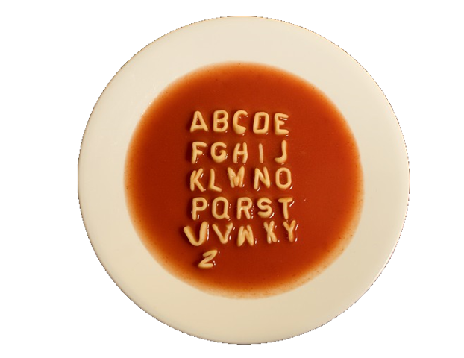

How to Find Nourishment from this Alphabet Soup
Carl Hatch-Feir
Ann Graham

Slide 2
How to Find Nourishment
Objectives:
  Learn how DSRIP funds can be used by a CD provider to fund population health strategies
  Learn how the flexibility of Health Home Care Management can be integrated with a school-based prevention programs, out-patient CD treatment, and prison reentry services.

Slide 3

What are Health Homes?
(And why should I care?)
Health Homes is not home health care…Nursing homes…or Housing…
Health Homes is the future of case management in New York
www.health.ny.gov has comprehensive information about the Health Homes initiative, complete with provider manuals.
Notes:
Care because this appears to be the way case management services will be delivered in NYS.

Slide 4
Health Home Care Management is a program that provides support to improve health outcomes for high-needs Medicaid recipients:
Medical, behavioral health and social service needs addressed
Boots on the ground care management offered
No cost for Medicaid recipients
Evidence-based person centered practices are used
The Health Home Care Manager oversees and coordinates access to all of the services a member requires
Notes:
NYS DOH came up with this as a way to decrease overutilization of ERs by medicaid recipients

Slide 5
How Can HH Care Management Help Your Agency/Your Clients?
Offers an additional resource for high need individuals you serve
Provides someone for the individuals you serve to call and obtain assistance with concerns that are not medical in nature
Coordinates community supports needed
Assists the individual with improving their quality of life
Adds value to the care you are providing
Assists in achieving important outcomes, like appointment adherence and medication adherence

Slide 6

Pros …
Fee for service billing
No limit on how many care managers you hire
Flexibility—you are not limited to any particular population
You are not restricted to serving only clients of your agency
A truly value-added service for your clients
Continuity of care—clients can keep their HH Care Manager regardless of where they are receiving treatment or services.

Slide 7

…and Cons
Fee structure is still being adjusted
Difficulties in connecting services to billing
Only paid for the first billable service each month
You’ll be expected to accept clients outside of your discipline
Very demanding, time-consuming documentation requirements
Clients referred for outreach by DOH are often not “findable”
Comprehensive assessment is lengthy and must be done by a higher level care manager
Notes:
Low, Medium, Hi, HH+. You are paid for outreach, but client lists include clients who are deceased, moved away, no longer on Medicaid, no current address or phone, etc. DOH pushes street level outreac Also, DOH has not done a good job of marketing this program. Medical providers are often completely unaware of it.

Slide 8
What type of staff make good HH Care Managers?
DETAIL ORIENTED
Excellent computer skills
Respects time deadlines
Wide knowledge of resources available in the community
Enjoys a challenge
Helpful if they’ve had experience in substance abuse treatment or mental health
At least one person needs a degree in a health or behavioral health field (comprehensive assessments).
Notes:
Although DOH tends to characterize this as a medical program, invariably, the clients we see have more behavioral health issues.

Slide 9
To participate in HH, your agency must be able to bill Medicaid for services, and a client must be receiving Medicaid and…
Have one of the following:
A serious mental illness
HIV/AIDS
Or two of the following:
Mental health condition
Substance abuse disorder
Asthma
Diabetes
Heart Disease
>BMI 25
Other chronic condition
Notes:
We do accept clients who appear to be eligible for Medicaid and then facilitate the application. Just understand that until the Medicaid case is actually open, you won’t be paid for any month you provided services when there was no open MA case.

Slide 10



How do clients enter the Health Home system?
The Health Home (GRHHN or HHUNY) refers individual clients to your agency, sends lists of potential clients generated by DOH
Your HH Care Managers send a Community Referral form to the Health Home
Notes:
GRHHN is the Greater Rochester Health Home Network; HHUNY is Health Homes of Upstate NY

Slide 11
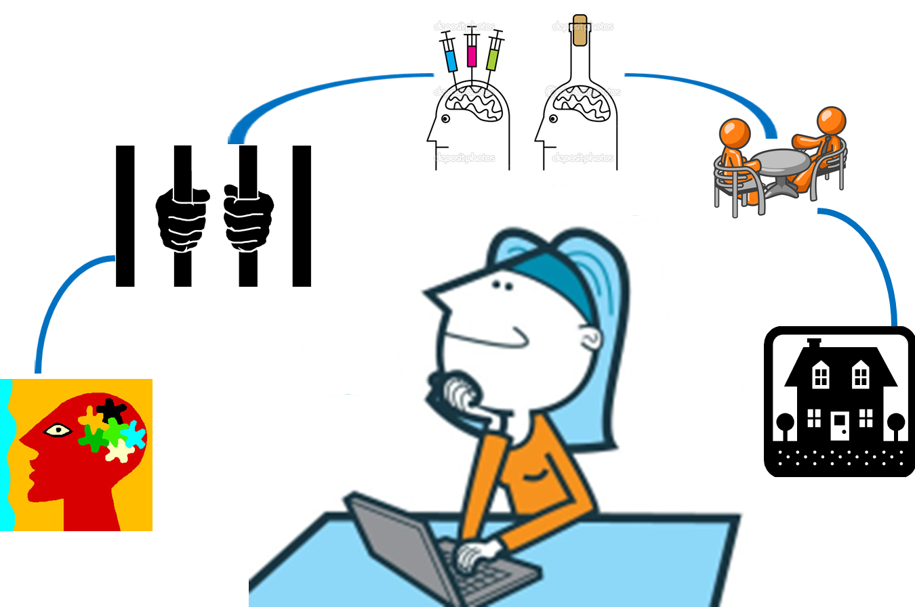
How can I use Health Home Care Managers?

Slide 12
To provide case management in programs where those services aren’t funded;
To extend and/or enhance case management services in existing programs;
To create strong partnerships with community agencies with a shared target population;
Notes:
Like drug court, mental health court; Like Reentry services that are short-lived and only funded for specific populations; Like Wilson Commencement, the methadone clinic, schools, Grace House

Slide 13
What do HH Care Managers actually do?
By doing things like…
Advocating for their client with a landlord;
Calling primary care doctors to get accurate information about a patient’s meds;
Helping a client find an apartment they can afford;
Connecting clients to Medicab services to get to medical appointments;
Listening to the client’s concerns about what they believe are the most serious issues they’re facing;
Care managers put the pieces of the puzzle together... They create links between primary care doctors, mental health providers, hospital staff, treatment programs, social workers, criminal justice agencies, courts, landlords, the Department of Social Services, Social Security, and community agencies.
They work with clients to improve their resources and ability to manage their daily lives successfully.

Slide 14

Care Manager vs. Case Manager…
What’s the Difference?
HH Care Managers have access to protected health care information via the DOH records system; HH Care Managers are considered health care professionals, regardless of the agency they are working in.
HH Care Managers must meet a high standard of service delivery and documentation, using an on-line case management system;
HH Care Managers can serve a client indefinitely; the client does not have to be a client of your agency. For example, a client who was receiving substance abuse treatment at Delphi can continue to have a Delphi HH Care Manager even after their treatment has ended;
HH Care Managers provide client-driven care. For example, a client may present with substance abuse issues, but, if they are only interested in getting help applying for subsidized housing, the Care Manager will work on the issues they have identified, while keeping other pertinent health issues in front of the client;
Notes:
You must provide 24/7 live response. It can be a little difficult when they try to refer cases that are outside your agency’s area of expertise.

Slide 15

Using HH Care Management in
School-Based Prevention
Teachers, school nurses, or administrators may identify a student who is struggling because of…
Unidentified or untreated medical or behavioral health issues;
Pending eviction or actual homelessness or a utility shut off
Insufficient food
Violence in the home
Substance abuse (themselves or a family member)
A parent who is incarcerated
Involved in the juvenile justice system

Slide 16
Connecting Students to a HH Care Manager
Health Home Care Managers can serve the adult in the household, or can serve the child directly.
The school can contact the parent or guardian to ask if they are interested in getting assistance, and connect the HH Care Manager to the parent or adult in the home.
The HH Care Manager can work directly with the student. The student does not have to get permission from a parent; the HH Care Manager does not have to share information unless the student signs a release of information.
Notes:
HH for children is starting soon.

Slide 17

Tiffany was 17 and attending a diversion program due to her chronic truancy. A Delphi prevention counselor stationed at her school contacted Brittany Clark, one of our HH Care Managers, to say she was concerned because Tiffany was a bright girl who was in danger of not graduating due to her absences. The prevention counselor asked Tiffany if she’d like to get some help, and she agreed to meet with Brittany.
After talking with Tiffany, Brittany identified several areas where Tiffany needed immediate assistance. Tiffany’s mother was home recovering from a major stroke, and Tiffany was often her only caregiver. There was little money in the house, and Tiffany was sometimes absent because she lacked bus fare.
Tiffany had become despondent about even finishing school; she was under pressure to start earning money. She was taking medication for anxiety and depression, but her constant fatigue was an indicator that her dosage may have needed adjusting. Like most teenagers, she was uncomfortable because she felt her clothes weren’t trendy. Tiffany’s anxiety over her mother’s health, her school situation, etc., made it more difficult for her to focus on her education.
Notes:
Tiffany’s mother knew that Tiffany was working with a HH care manager, but because mom couldn’t communicate because of the stroke, the HH Care manager talked with step father and older sister. Care Manager followed up with doctor’s office when they didn’t get back to Tiffany.

Slide 18
Over the next two months, Brittany:
Got Tiffany tutoring through the Urban League Black Scholar Program (HH Care Manager was concerned that school was not meeting Tiffany’s IEP).
Helped her get her learner’s permit
Scheduled an appointment with Tiffany’s pediatrician and accompanied Tiffany to the appointment, where they discussed her current medication and how the medications were making her so groggy she had difficulty getting up, as well as focus in school
Supported Tiffany getting regular exercise
Helped her get a part-time job at St. Anne’s Home, made sure she had appropriate interview clothes, and did a mock interview with her.
Provided an ear for Tiffany to talk to, who could help actually solve some of her most pressing issues
Tiffany is now preparing to graduate in January, and feels much more in control of her life than she did previously.

Slide 19
Using HH Care Manager to Support a Criminal Justice Caseload
Delphi serves more than 600 high-risk parolees each year, through a contract from the NYS Division of Criminal Justice Services. The contract provides for a limited amount of case management services, provides some funds for wrap-around needs, and is limited to serving mid- to high-risk parolees.
Using a HH Care Manager, we have been able to provide the same high level of services to men and women leaving Federal incarceration.
We are part of the new HH Criminal Justice Pilot Program that allows HH Care Managers to begin serving men and women prior to release, an essential component of evidence based reentry services
We are able to extend service beyond the short period of time the grant funding covers for clients who have on-going needs, particularly those with serious mental illness, on-going substance abuse issues, or serious medical concerns.
Through these efforts, we have now been awarded a grant to provide supported forensic housing, utilizing a HH Care Manager.
We’ve been asked by our local Probation office to participate in the Call-In, by providing a HH Care Manager to work with 18-24 year old, gang-invested young men, who are at high risk of violence and continued involvement in the criminal justice system.
Notes:
Here’s an example of how you can shore up an existing program and expand into additional areas. This is not double dipping. It allows you to potential delineate more funds for something like wraparound, and potentially save a salary. These are just the beginning of how HH can be used, we also parter with Wilson Commencement Park, the methadone clinic, etc.

Slide 20
HH Care Management in Outpatient CD
HH Care Managers are a natural match to serve treatment courts, such as drug court and mental health court. They are able to work with the client for long periods of time, even if the client is no longer receiving treatment (as long as they continue to receive Medicaid).
HH Care Managers can provide supportive services like filling out forms for housing or benefits, providing referrals, or guiding clients to needed resources, that can take up precious clinical time.
Notes:
What are the qualifications of an HH care manager? These haven't been established with any hard and fast rules, but the standards for conducting the comprehensive assessment requirements someone with a degree in a health or behavioral health field.

Slide 21
What is DSRIP?
Delivery System Reform Incentive Payment (DSRIP)
Represents an investment of $6.42 billion over five years
Funds are distributed via 25 regional Performing Provider Systems (PPS)
May be spent on up to 11 approved projects the PPS proposed from a list of approved projects
Targets a 25% reduction in unnecessary ED visits and re-hospitalizations
Funds are conditioned on the entire State achieving that metric

Slide 22
How is it structured?
Funds are distributed based on meeting objectives in four domains
  Domain 1 is about the PPS structure and governance
  Domain 2 is about System Transformation Projects (Infrastructure)
  Domain 3 is about Clinical Improvement Projects
  Domain 4 is about Population-Wide
  A Bonus Category is available to increase Patient Activation

Slide 23
Where do CD Providers fit in?
Every PPS must select at least one Domain 4 Project
  4.a.i – Promote mental, emotional and behavioral well being in communities
  4.a.ii – Prevent substance abuse and other emotional disorders
  4.a.iii – Strengthen mental health and substance abuse infrastructure across systems
  4.b.i – Promote tobacco cessation…especially among those with poor mental health
  4.b.ii – Increase access to high quality chronic disease preventive care and management
  4.c.ii – Increase early access to, and retention in, HIV care
  4.d.i – Reduce premature births

Slide 24
What is the opportunity?
DSRIP is incredibly concrete about the metrics that must be achieved in Domains 1, 2, and 3
Domain 4 projects have very broad latitude to develop their own process-based metrics
OASAS has a well developed provider system with experience in selecting and implementing evidence-based programs
DSRIP allocates 5% of the total PPS award to domain 4 projects

Slide 25
What is the opportunity?
The goal of domain 4 projects is to select, pilot and document evidence-based programs that make a measureable difference within the PPS region
Data from cost effective pilots is to be used to obtain on-going funding from managed care organizations after the five year DSRIP process concludes

Slide 26
What is Patient Activation?
Patient activation is about identifying and engaging patients:
  Who are overwhelmed and not attending to their health
  Who are aware but struggling with what to do and how to do it
  Who need some support to get started
  Who need help in maintaining healthy behaviors and self-care management

Slide 27
Patient Activation!
CD Providers bring a wealth of experience with:
  Case Management
  Motivational Interviewing
  Stages of Change
  Client Centered Systems of Care
You are the experts and you bring something very valuable to the table

Slide 28
Questions???
Contact information:
  Carl Hatch-Feir – chatch-feir@delphidrug.org or 585-467-2230 ext. 435
  Ann Graham – agraham@delphidrug.org or 585-467-2230 ext. 303

