Slide 1
NYS ASAP 16th Annual Conference
Transformation and Innovation for Success
Dr. Jorge Petit, Regional Senior Vice President, New York Region

Slide 2

Agenda
Welcome and Introduction
Who We Are
  New York State Region
System Transformation
Provider Partnership and Practice Transformation
The Road Ahead
Notes:
Good morning and thank you for that introduction. Its such a pleasure to be here with you all this morning in beautiful Saratoga Springs.
As was just stated I started at Beacon 1 month ago and little did I imagine that not only did I jump in the deep end of the pool but it was a pool in the middle of an oncoming tsunami…of HARP, ICD-10, LOCADTR. Wow its been quite a month for me as it has been for the entire system of care in NY. Before I start I’d like to add a few more important details about my background…
NYC DOHMH – promoted the training and awareness of buprenorphine and it’s use in NYC and as well as promoted SBIRT training; prior to that I was the Medical Director of an outpatient drug/alcohol program.
I als want to introduce our team that’s here today…
Alan Boardman
Vice President, Client Partnerships
Downstate New York Region
Renee Abdou-Malta
Vice President, Client Partnerships
Upstate New York Region
Jennifer Rice
Regional Director of Operations

Slide 3
Who We Are

Slide 4



Who We Are
Integration
Transformation
Notes:
BEACON Health Options is the combined organization of two (2) of the country’s most prominent behavioral health organizations: Beacon Health Strategies and Value Options. Created to provide the scale and infrastructure necessary to serve the nation’s largest plans and we are about 9 months into the merger.

Slide 5
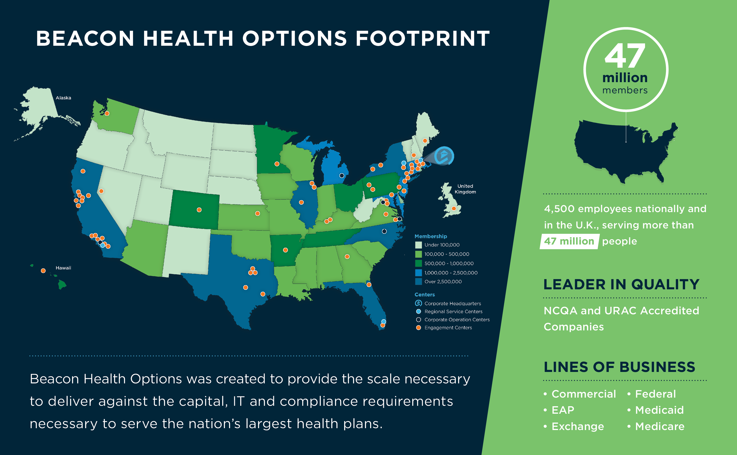
Who We Are
Notes:
As combined companies we now serve more than 47 million people across all 50 states plus the UK with about 4500 employees.
We partner with health plans and companies to help their members and employees lead healthier, more productive lives.
We are in the commercial, federal, Medicaid, Medicare, Exchange and EAP space and we offer the health plans:
Comprehensive network that furnishes a full array of Behavioral Health services spanning the continuum of care to promote recovery
Plan based Intensive Case Management for high-risk members
Integrated Partner Model that facilitates the integration of Behavioral Health services with physical health and pharmacy services
Utilization Management principles used to conduct care coordination activities and ensure treatment occurs in the most appropriate setting
Parity-compliant program development

Slide 6

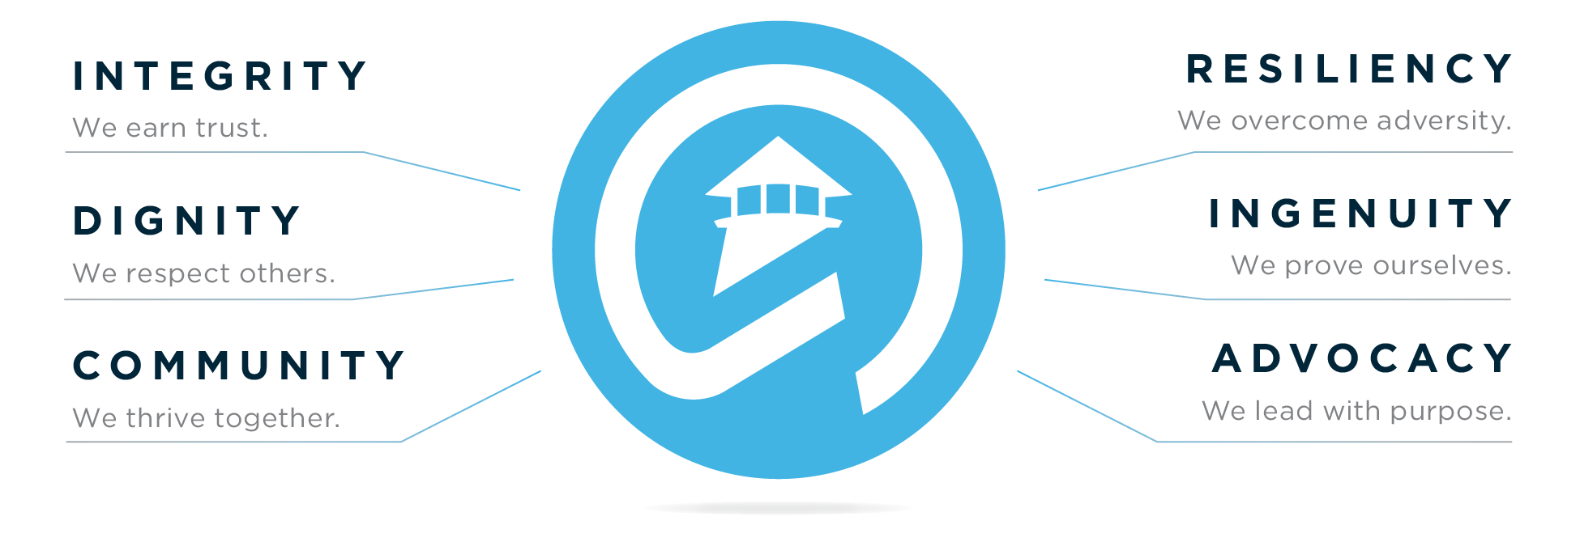
Who We Are
Notes:
Beacon Health Options is the premier behavioral health company in the marketplace with a mission-focused commitment to those we serve.
We are a company passionate about helping people with mental illness and addiction live their lives to the fullest potential.
We focus on the recovery and resilience of our members and their families.
We are people with shared experiences who work to help our members every day.

Slide 7
New York State Region

Slide 8























New York State Region
Segment | Highlights | Client Base
State Direct | Partnership w/ Empire dating back 23 years 1.2M covered lives through Empire
Autism Specialty | Statewide autism services management
Medicaid/ QHP/HARP/ Medicare | Completed submission of downstate QHP/HARP RFQ 8 QHP plan partners 7 HARP plan partners OMH/OASAS- contracted network
Commercial / HIX | Statewide HIX expansion
FIDA/MLTC | 10 FIDA partners Live with SWH for MLTC
RBHO
Notes:
In New York State we have several offices…
Our Service Center is in Latham New York and what we call our Engagement Center is in NYC located in 1 and 2 Penn Plaza
Many of our staff are also co-located at some of our accounts.
We currently serve more than 5.5 million New Yorkers statewide across multiple product types:
Commercial
Medicare
Medicaid
Exchange
SNPs
Dual demonstrations
We are the chosen behavioral health partner for 19 New York-based health plans

Slide 9
System Transformation

Slide 10
System Transformation
Once in a lifetime confluence of policy initiatives…
Mental Health Parity and Addiction Equity Act of 2008 uncaps benefits
ACA is one of the largest coverage expansions of behavioral health in our history
Notes:
The transformation of our system, especially for MH and substance use disorder benefits and access, has been in the works for a while now and let me add some context to this process. At the Federal level with the passage of the Affordable Care Act we expanded benefits to “childless adults” and the Mental Health Parity and Addiction Equity Act (MHPAEA) made access to BH services on par with medical services.
The consequences of these two changes include:
Expanded mental health benefits to 62.5 million people
Access to substance use disorder benefits to 32.1 million individuals
Increasing pressure on health care delivery system to provide effective substance use treatment

Slide 11
System Transformation
WA
ME
VT
MT**
ND
OR
MN
NH*
MA
ID
WI*
NY
SD
MI*
CT
RI
WY
PA*
NJ
NE
IA*
OH
MD
DE
NV
IL
IN*
WV
UT
CO
VA
CA
KS
MO
KY
NC
TN
AZ
OK
AR*
SC
NM
GA
MS
AL
TX
LA
AK
FL
HI
Adopted (31 States including DC)
Adoption Under Discussion (1 State)
Not Adopting at this time (19 States)
Source: KFF, Updated July 20, 2015
Notes:
Nationally many states decided to expand their Medicaid programs which has meant that
Commercial plans now have an unlimited benefit package (which they didnt manage before in many cases)
Coverage to age 26 puts first psychotic breaks in commercial coverage world
As Medicaid expands coverage, entitlement populations with access to comprehensive benefit is growing
MH/SA benefits are expanding with new frontiers driven by understanding of social determinants of health: Housing, voc rehab, peer supports, technology, etc.

Slide 12
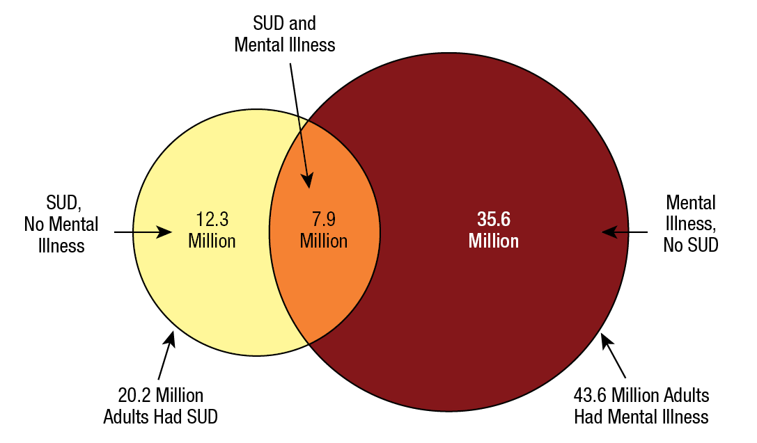
System Transformation
Notes:
Why is this necessary, important and timely?
Results from the 2014 National Survey on Drug Use and Health
Past Year Substance Dependence or Abuse and Serious Mental Illness among Adults Aged 18 or Older: 2012
Among the 20 million adults aged 18 or older in 2012 with a past year substance use disorder about 8 million also had a SMI

Slide 13
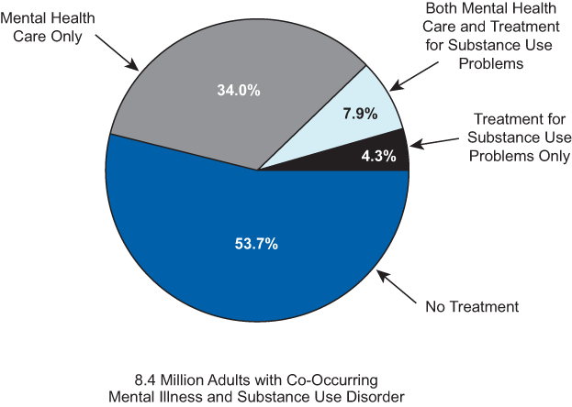
System Transformation
Notes:
Most strikingly though…when you look at Past Year Mental Health Care and Treatment for Substance Use Problems among Adults Aged 18 or Older with Both Mental Illness and a Substance Use Disorder (2012) you see that over 50% had received no treatment.

Slide 14

System Transformation
FRAGMENTED HEALTHCARE SYSTEM
SEPARATE FUNDING STREAMS
DISCONNECTION OF MIND FROM BODY
POINT OF CARE BARRIERS TO SERVICES
BURDENSOME REGULATORY PROCESSES
MISALIGNED INCENTIVES

Slide 15


System Transformation
Notes:
In NY State Medicaid Redesign convened by Gov Cuomo was charged to address high cost/high needs members as the primary cost drivers. High spend has been shown to be the direct result of a failure to effectively “manage” a member’s needs.
The charge was to:
Effectively Integrate Behavioral Health and Physical Health Care Services
Advance the Concept of Health Homes and Other Innovations to Ensure Service Integration, Particularly for Those with Serious Behavioral Health Needs
Explore Opportunities for Service Co-location, Peer Support, and Enhanced and Integrated Managed Addiction Treatment Services
Embark on a Transition to Fully Integrated Medicaid Managed Care in a Phased Process that Preserves the Integrity of the Public Behavioral Health System and Protects the Interests and Well Being of New York’s Most Vulnerable Residents

Slide 16
System Transformation
The outcome was a multi-pronged approach to the incorporation of behavioral health services for adults into Medicaid Managed Care…
Qualified Mainstream MCO’s/ Qualified Health Plan (QHP)
Health and Recovery Plans (HARPs)/ Special Needs Plans (SNPs) HARP eligible
HCBS Waiver Services
Notes:
Qualified Mainstream MCO’s/ Qualified Health Plan (QHP)
For all adults (21 and older) served in Mainstream MCO’s across the State
Integrates all Medicaid State Plan covered services for mental illness and substance use disorders to reduce service delivery fragmentation
Emphasis on quality outcomes that address total wellness, prevention, and the integration of Behavioral Health services with physical health services
Health Plans will be expected to meet targeted Behavioral Health expenditure targets and administrative costs
Utilization management practices should feature clinical algorithms to identify vulnerable members in need of better engagement in preventive care to promote the “triple aim” of evidenced based treatment occurring in the right setting at the right time
Health and Recovery Plans (HARPs)/ Special Needs Plans (SNPs) Harp eligible
Distinctly qualified, specialized, integrated managed care product for adults meeting serious mental illness and SUD targeting criteria and risk factors
Provides access to enhanced benefit package in addition to all medical and carved in QHP services, including an array of home and community services designed to help maintain participants in home and community based settings.
Qualified HARP’s, contracting with Health Homes, will provide care coordination for all services including HCBS services
Specialized staffing requirements
Enhanced performance metrics and incentives to achieve health, wellness, recovery and community inclusion for members
Mandated Medical Loss Ratio
HCBS Waiver Services
The Centers for Medicare and Medicaid Services (CMS) authorized HCBS Waiver services under Medicaid waiver authority.
The goal is to promote improvements and move toward a recovery-based managed care delivery model.
The recovery model of care, as envisioned in the HARP and HIV SNP models, emphasizes and supports an individual’s recovery by optimizing quality of life and reducing symptoms of mental illness and Substance Use Disorders through empowerment, choice, treatment, education, employment, housing, and health and well-being.
HARPs and HIV SNPs provide BH HCBS as a covered benefit for qualified members. HARPs and HIV SNPs must create an environment where the plan, service providers, plan members, families and other significant supporters, and government partner to assist members in prevention, management, and treatment of physical and behavioral health conditions, including serious mental illness and Substance Use Disorders.

Slide 17
System Transformation
Psychosocial Rehabilitation
Community Psychiatric Support and Treatment
Habilitation
Family Support and Training
Short-term Crisis Respite
Intensive Crisis Respite
Education Support Services
Empowerment Services - Peer Supports
Pre-vocational Services
Transitional Employment, Intensive Supported Employment, Ongoing Supported Employment
Non-Medical Transportation
Notes:
HCBS Services in HARP/SNP Benefit Package include…

Slide 18
System Transformation
OASAS Program/Services that are transitioning to Managed Care
Clinic
Opioid Treatment Program
Outpatient Rehab
Notes:
Clinic includes IOP and partial

Slide 19
System Transformation
Raising the bar on behavioral health management for all members:
  Expertise and experience, network, access, service utilization/ penetration, care coordination
  Quality Measures “beyond HEDIS”
  Engaging the disengaged
  Promoting consumer empowerment
Assure reinvestment of savings in services and supports for people with behavioral health needs
Ongoing monitoring by the entire behavioral health community

Slide 20
System Transformation
Incentive payments based on performance (Value-Based Purchasing)
Minimum Medical Loss Ratio (MLR) requirements
Minimal access to ambulatory detox results in longer inpatient stays and unnecessary hospitalizations
Administratively complex medication assisted treatment processes
Access to and significant cost associated with supportive therapies such as Vivitrol

Slide 21
Provider Partnerships and Practice Transformation
Notes:
I’m going to talk about what Beacon can do to work with providers and assist in transforming how we do things…

Slide 22
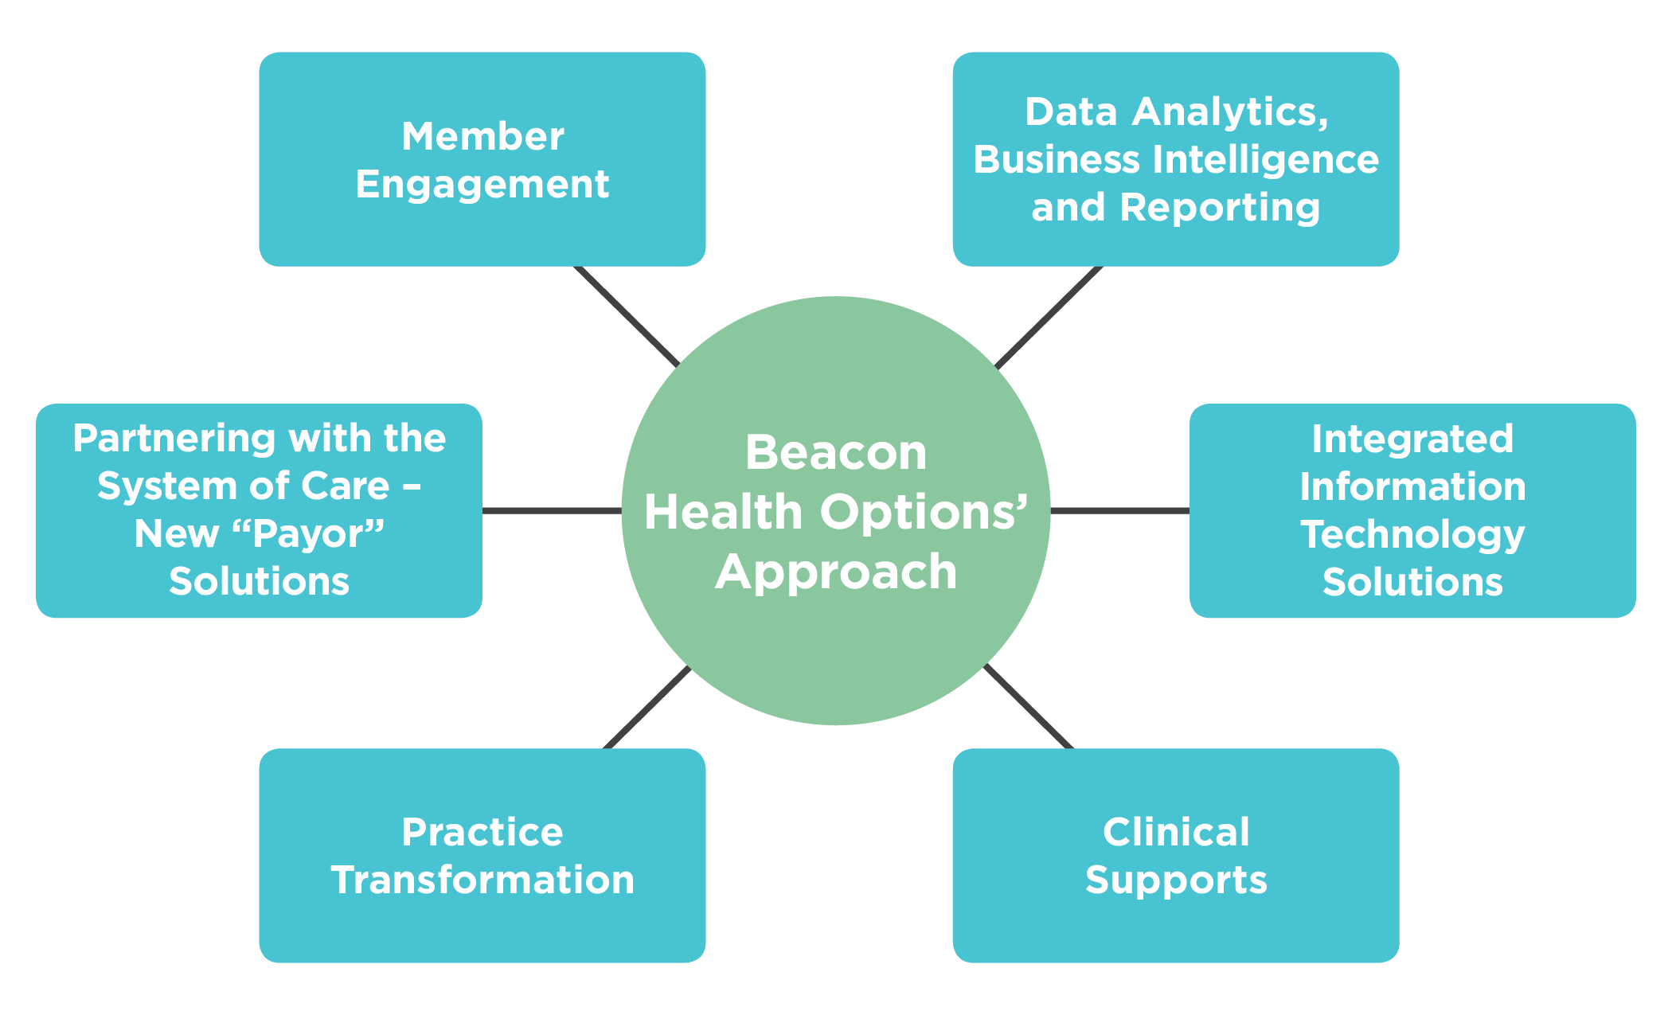
Our Approach…

Slide 23

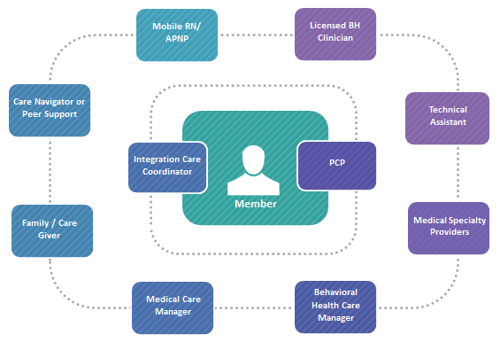
Member Engagement
Proactive and targeted health education and information
Education linked with service –
a progressive continuum of interventions
Leverage health plan initiatives and resources
Address Modifiable Health Risks
Connect Members to Pro-health Activities
Link Members to Health Incentives
Improves Health Literacy

Slide 24


Data Analytics, Business Intelligence and Reporting
Risk stratification and predictive modeling
Quality reporting at member and aggregate levels using best-practice performance metrics
Individual provider profiling and panel comparative reporting
Integrated health clinical and financial analytics
Psychotropic Drug Intervention Program (PDIP): Analytic intervention to identify aberrant prescribing and support appropriate dosing, adherence, and evidence-based polypharmacy
Integrated Practice Assessment Tool: How “integrated” is my practice?

Slide 25

Member Identification through Analytics
MEANINGFUL
PREDICTIVE MODELING
Population analysis using historical utilization data to stratify and assign initial risk scores, identify care gaps and inform the predicted intensity of care management intervention
Continuous re-analysis and re-stratification to capture emerging risk
Comprehensive health risk assessments upon engagement to validate the initial analytic risk rating by adding psychosocial risk factors not typically found in utilization data and assigning an acuity of need rating to further inform care management support resources
Specialty Behavioral Health for Intensive Care Management and Care Coordination
Integrated Health: Cost, Utilization, Chronic Conditions, Medication Non-Adherence
Risk Adjustment (HealthScape): Identification of “undiscovered” members
Notes:
Our iterative analytic approach includes descriptive and evaluative statistical methods that can be flexibly applied for targeted cohorts. To determine the correct intensity management level for each individual, we proceed with…

Slide 26

Technology Enablers
Computer-based CBT and online counseling to extend treatment and help bring about cost-effective care. This includes mobile CBT applications that can be directed by a clinician or an individual
Mobile and communication platform technologies that enable individual participation in care including technology to send/receive individual texts and create appointment reminders and follow-up items
Telehealth and video-counseling to increase individual access to services
Notes:
Examples of national models

Slide 27
Evidence Based Practice
Resources and training on appropriate use of instruments:
  Standardized screenings for a variety of issues including, but not limited to depression, anxiety, substance use disorders, and post-traumatic stress disorder
  Semi-structured assessments for common co-occurring medical conditions, health risk behaviors, and adherence to preventative care recommendations
Notes:
As OASAS licensed providers looking to integrate MH or Medical services we can assist that through EBP tools, techniques and TA/training

Slide 28
Practice Transformation Consultants
Baseline Assessment
Monitoring for Continuous Quality Improvement
Implementation
Action Planning
Consultant Responsibilities
Provide targeted trainings Conduct clinic workflow redesign Identify/develop appropriate clinical service delivery model Develop operating protocols Determine appropriate screening instruments Provide examples of job descriptions, joint operating protocols, standard operating procedures, and information regarding coding/billing | Aid in identification of referral partners and structuring agreements that address protocols, standards of practice, and interventions Troubleshoot inter-agency issues that compromise effective integration strategies Assess documentation processes for compliance with relevant statutes Assist with quality management/process improvement of integrated services
Notes:
Manager Provider Partnerships
Because there is no one correct model of integration, and because practices vary greatly in terms of their philosophies, resources, and other unique variables, solutions must be tailored to an individual practice’s needs
Consultants provide a continuum of services that are necessary for ensuring successful integration initiatives through 4 phases of work modeled after the plan-do-study-act approach to practice improvement:

Slide 29
Comprehensive Network Solutions
Comprehensive network
Improved member access
Technical support
Ongoing training & development
Traditional behavioral health services
Inpatient care
Residential treatment
Detoxification
Medication management
Non-traditional behavioral health services
Peer support services
Pre-vocational services
Family support and training
Supportive housing
Long-term support services (LTSS)
Assisted living
Nursing home care
Respite
Home delivery meals
Psychosocial interventions
Employment
Jail diversion
Cognitive Behavioral Therapy
Assertive Community Treatment
Notes:
Beacon will work with you on the coordination of care across the spectrum...we have all these services in our network

Slide 30
Provider Supports: Technical Assistance
Employs field-based licensed clinicians who collaborate with contracted providers to ensure that program operations and service delivery adhere to Recovery-oriented System of Care (ROSC) principles and consistently focus on key factors that result in effective treatment
Beacon Technical Assistance Coordinators (TAC) conduct broad clinical oversight of the program to the contracted SMI providers
  Quarterly review of care plans
  Daily and weekly Rounding meetings
  Ad hoc case consultation and troubleshooting

Slide 31
Outcomes Measures and Reporting
CLINICAL OUTCOME MEASURES
Psychiatric Drug Intervention Program (PDIP) outcomes—medication adherence and best practice prescribing
Plan—All cause readmissions
Improved functional status and quality of life
Reduction in high-risk behavior (e.g., sexually transmitted diseases, smoking, and substance use)
Achievement of Individual Care Plan goals
Appropriate use of hospital emergency rooms and avoidance of non-emergent use
PROCESS MEASURES
Annual routine health care, physical exam
Screening and management of metabolic indicators for chronic conditions (e.g., hypertension, diabetes, and hyperlipidemia)
Adult Body Mass Index (BMI)
Creation of an Individual Care Plan
Metabolic monitoring for antipsychotic medications
Follow-up after hospitalization for mental illness
Routine screening of co-occurring substance use, risky drinking/drug use
Depression screening and follow-up plan
INDIVIDUAL EXPERIENCE OF CARE MEASURES
Individual satisfaction
Social connectedness
Notes:
From a menu of more than 100 possible measurements informed by national oversight bodies including CMS, NCQA/HEDIS, State Divisions of Health, NQF, and AHRQ we have selected 16 priority measures as key indicators for our integrated program…as an example.
We need to work together to determine which one make the most sense for you and make proposals to OASAS.

Slide 32
The Road Ahead

Slide 33
The Challenges
Beyond bringing about systems transformation, the laudable goal and expectation of systems transformation is especially daunting.
Implementing this visionary transformation through many competitive health plans, with uneven network management capacity; few, if any of whom have the experience to confidently deliver on the high bar expectations established in the RFQ.
Overcoming the historical fragmentation and the “silos of excellence” that characterize much of the State’s public behavioral health system.
Ensuring critical and largely absent cross systems communication, collaboration and integration (child welfare, criminal justice, homelessness services), particularly crucial for many of our most vulnerable and marginalized residents.

Slide 34
Challenges….There’s More
Building an accessible and responsively integrated delivery system that begins to meet the needs of 3 million Medicaid beneficiaries, including more than 60,000 individuals with immensely challenging behavioral health issues and needs.
Establishing a rich array of services never managed by plans, including Crisis Teams and HCBS services critically important to achieving New York’s expected recovery-relevant outcomes…also totally new to the plans.
Adapting to multi State and City agency oversight of this initiative, new partners (DOH, OMH, OASAS, DOHMH), none of whom have significant experience in managing health plans.
Doing so with providers many of who are struggling financially, and many others inexperienced with the vagaries of managed care; indeed some who are only now experiencing the challenge of FFS medicine.

Slide 35
….and More
  Claims Testing, Cash Flow Concerns, Advance Payments
  Providers who are unnerved by standard, complex and unalterable managed care contracts
  Parity Concerns and related transitional UM and Continuous Episodes of Care Concerns
  Unlicensed practitioners, un-contracted providers (OTP’s, ACT, CPEP’s)
  Lifting of OTP Capacity Restrictions
  General uncertainty related to rate issues, premium adequacy and related risk adjustment, risk sharing and risk mitigation considerations

Slide 36
The Road Ahead
Expand provider networks
Build full-service continuums of care
Devise creative contracting and reimbursement strategies
Align incentives with improved outcomes
Member engagement needs to be local, include peer navigators and engage new technologies to involve members in their treatment
All levels of prevention are crucial, and include educational campaigns, medication disposal or buy-back programs, community availability of opioid antagonist medication to reverse unintentional overdose
Increase access to Medication Assisted Treatment protocols
Support the establishment of facilities offering ambulatory detox
Notes:
Care Delivery Transformation requires that we provide improved, individualized, evidence-based care. To do so we will need to…

Slide 37

The Road Ahead
Payment Models for Integration
  FFS: conceptually sensible; coding and billing are administratively complex
  Enhanced PMPM: usually focuses on care coordination; does not cover care delivery
  Capitation: debate about what services should be covered
  Bundled Payment: debate about inclusion criteria and treatment parameters
  Pay for Performance: most rely on process measures; relevant outcome measures are not typically claims-based
Notes:
Done in other markets and want to bring to NY and work with you on getting to value based payments…

Slide 38
The Road Ahead
Move away from transactional interactions with providers
Our expectations of our UM reviewers and MD’s will change as it relates to the use of peer advisor review and consultation
Our expectations of our “Select” network facilities and providers will change and call for increased facility management oversight and increased facility accountability
Our management teams will utilize data to manage their clinical teams and drive decision making
Our utilization management activities will decrease and our focus will increase related to discharge planning, transitions of care and intensive case management engagement

Slide 39
The Road Ahead
Lastly…we need to move to a new paradigm and embrace a chronic care model….if we recognize addiction as chronic illness it provides an evidenced based framework to:
Increase quality of care
Reduce costs
Improve outcomes
Notes:
For example…opioid addiction must be treated as the chronic disease it is, with a relapsing and remitting course, just like diabetes or asthma. Like other chronic diseases, it requires ongoing management measured in years rather than days. We need to build a nimble health care delivery system to address the chronic nature of opioid addiction through a continuum of services that promote evidence-based, person-centered care.
Beacon’s White Paper on CONFRONTING THE CRISIS OF OPIOID ADDICTION from May 2015 lays out a series of Recommended actions for policymakers to combat opioid addiction. If we can implement the six tenets of the Chronic Disease Model of Care it will require a major redesign of the current health care system but this redesign is fundamental and will help combat the opioid crisis through acknowledging and treating opioid addiction as a chronic disease. Beacon is ready to embark on this challenge and I hope you all are too.

Slide 40
Thank you.

