Slide 1
Meeting with ASAP of NYS:
OASAS Prevention Update and
Funding Opportunities
Albany, NY

Slide 2





NYS Drug Use Trends for High School Students in Grades 9-12
Trend Summary
Alcohol down since 1997
Heroin up since 2005
Marijuana & Cocaine steady
Cigarettes down from 1997,
however, in 2015:
Tobacco vaping = 22%
Any Nicotine 30 day = 29%
%
Source: Youth Risk Behavior Survey, NYSED, 2016.

Slide 4
Evidence-based Staff Allocation
Preliminary – 2017-18 Planning
EBP Education | 53%
EBS Environmental | 5%
EBP Counseling | 3%
EBP Early Intervention | 9%
Planned NYS EBPS Prevention | 70%

Slide 5
OASAS Prevention EBP Education
PPY 2016-2017, Preliminary
EBP's | Participants Served | Provider Count
TGFD - Too Good For Drugs - Elementary {10} | 37,538 | 85
TGFD - Too Good For Drugs - M.S. {10} | 20,891 | 80
LST - Life Skills Training - Elementary {8} | 30,119 | 74
TGFV - Too Good for Violence - Elementary {7} | 25,406 | 65
LST - Life Skills Training - M.S. {15} | 23,628 | 64
TGFDV - Too Good for Drugs & Violence - H.S. {10} | 11,914 | 64
Second Step - Elementary - Grade K-5 {22} | 22,288 | 57
LST - Life Skills Training - H.S. - Booster {10} | 10,499 | 49
TGFV - Too Good for Violence - M.S. {9} | 5,763 | 48
SPORT {-} | 5,388 | 35
Second Step - M.S. - Grade 6-9 {13} | 8,921 | 33
Project SUCCESS {8} | 10,716 | 31
TND -Project Toward No Drug Abuse {12} | 6,216 | 31
LST - Life Skills Training - M.S. - Level 2 Booster {10} | 5,149 | 24
Refuse, Remove, Reasons - H.S. {5} | 5,217 | 21
LST classes = 71,000 28% of total
TGF classes = 101,000 40% of total
51 different EBP versions delivered
30 EBPs delivered by 1-3 providers

Slide 6
OASAS Prevention EBP Education
PPY 2016-2017, Preliminary
By School Grade Group
School Grades | Participants | %
Elementary | 122,881 | 49%
M.S. / J.H. | 81,993 | 33%
High School | 46,069 | 18%
 | 250,943 | 100%

Slide 7
Evidence-Based Program
and Strategies (EBPS)
Panel

Slide 8
EBPS Panel Review
Identify effective substance abuse prevention programs
Rate the strength of documented evidence
Maintain a registry of EBPS
Disseminate the results of panel reviews to providers

Slide 9

Strengthening Families Program
(SFP)

Slide 10
SFP Outcome Research
Randomized Control Trial – Waitlist Design
Five NYC Providers
Approximately 80 Parents
Pre and Post Tests Measurements

Slide 11
Mental Emotional Behavioral (MEB) Health Indicators

Slide 12
Kids’ Well-Being Indicator Clearinghouse (KWIC)
Free or Reduced Price Lunch (Grades 1-6)
Not Proficient in English Language Arts (ELA) (Grade 3)
Not Proficient in Math (Grade 3)
Special Education Services and MEB-related Disability (Grade 1-6)
School Suspensions/Expulsions/Removals (Grade K-12)

Slide 13

New York State Education Department (NYSED)
& New York State Office of Alcoholism and Substance Abuse Services (NYS OASAS)
Memorandum of Understanding (MOU) Project:
Promoting Positive Mental, Emotional
and Behavioral (MEB) Health
Laura R. Ficarra, M.S. Sp.Ed., Ph.D.
Prevention Planning and Education Coordinator
NYS OASAS

Slide 14

Schools as Prevention Partners
Schools and the classrooms within them are primary environments for preventative efforts (McIntosh, Chard, Boland, & Horner, 2006; Oliver & Reschly, 2007; Walker, 2000).
NYSED’s Social & Emotional Development & Learning (SEDL) Guidelines (2011)
SAMHSA’s Prevention Policy Academy (2012)
NYS Legislation (June 2014)

Slide 15
Frameworks as the Driver
RTI: Response to Intervention
Public Health Model
PBIS: Positive Behavioral Interventions and Supports

Slide 16




Multi-Level Influences
Risk Factors
Protective Factors

Slide 17
NYSED-NYS OASAS MOU Partnership Update
Key Stakeholders: NYSED, NYS OASAS, OASAS Prevention Provider Network
Impetus: June 2014 NYS Legislation mandated in the prevention clause:
  Heroin and Opioid content within Health Education drug and alcohol curricula;
  provisions for guidance and resource support to assist teachers in addressing this area
Released: June 2016
Health Education Standards Modernization Supplemental Guidance Document: An Instructional Resource Packet
  supplements the existing NYS Health Education guidance document to assist teachers in addressing new content for Heroin and Opioids in a developmentally-sensitive manner with resources for grades K-12
  features required functional knowledge (e.g., content) related to Heroin and Opioids and helpful optional instructional resources
  offers an opportunity for prevention providers to assist with the roll-out of this content and enhance school relationships

Slide 18
NYSED-NYS OASAS MOU Partnership
(continued)
Released: August 2016
The Kids’ Well-being Indicator Clearinghouse (KWIC) now includes data on Mental, Emotional and Behavioral (MEB) Health Indicators at the county- and school-district levels for multiple years. This information can be utilized to assist with resource allocation and needs assessment. Specifically, the tool will help to identify areas and school districts whose population is at higher risk for substance abuse and could benefit from evidence-based social and emotional development programming.
Released: March 2017
The Problem Gambling Prevention Toolkit for School Districts has been launched statewide. The new comprehensive Toolkit is designed to be used by New York State school administrators, educators, pupil personnel services, parent-teacher associations, parents, and community groups to teach students and parents about preventing underage gambling. The Toolkit includes such resources as sample school-based policies, evidence-based curricula, and ways to communicate with students about the potential risks of gambling behaviors as well as warning signs.

Slide 19
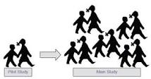
NYSED-NYS OASAS MOU Partnership (Cont’d)
In Progress: OASAS Pilot Program
Overview: The goal of the pilot program is to build the capacity of sustainable school and community infrastructures within a systematic process for improving health and academic outcomes by focusing on prevention education and activities of engagement, assessment, application, and evaluation. These efforts focus on prevention education related to tobacco, alcohol, and other drugs in support of decreasing Mental, Emotional and Behavioral (MEB) health disorders.
When: Began in Sept. 2016 year and lasts for 3 full and consecutive school years (e.g., through June 2019)
Who: Elementary schools in three public school districts (e.g., Schenectady, Syracuse, Hudson Falls)
What: OASAS prevention provider-supported implementation of a universal prevention EBP that has effects on substance abuse and mental health outcomes (i.e., PAX Good Behavior Game; Positive Action).

Slide 20
Prevention Guidelines Updates
Online Reporting References changed from PARIS to WITNYS
Problem Gambling Policy
SAPST Policy
Changes to Prevention Counseling Section
Updated links in Justice Center Section
Evidence-Based Programs (EBPs) for the Prevention of Mental, Emotional and Behavioral (MEB) Health Disorders
Updates to Appendices
Minor format changes

Slide 21
Prevention Coalitions
117 diverse prevention coalitions are registered with OASAS and are strengthening their communities across the state.
OASAS funds six regional Prevention Resource Centers for training and TA of coalitions & providers [SPF planning, EBP, evaluation].
2014-19 SAMHSA PFS grant: Funded 10 coalitions to reduce Rx Opioid and Heroin abuse and overdoses.

Slide 22
Partnership for Success (PFS)
Five year SAMHSA grant (2014 -2019)
10 sub recipient community coalitions identified through a competitive RFP process
Following Strategic Prevention Framework (SPF)
Community-wide strategies to reduce prescription drug misuse and abuse and heroin and opioid abuse and overdose prevention for those 12-25 years old.

Slide 23
SAMHSA’s
Strategic Prevention Framework Steps
Assessment
Profile population needs, resources, and readiness to address needs and gaps
Capacity
Evaluation
  Sustainability &
Cultural Competence
Monitor, evaluate, sustain, and improve or replace those that fail
Mobilize and/or build capacity to address needs
Implementation
Implement evidence-based prevention programs and activities
Develop a Comprehensive Strategic Plan
Planning
Notes:
23

Slide 24
Goals of the PFS Grant
Goal #1: Reduce prescription drug misuse and abuse in the 12-25 year old population
Goal #2: Reduce heroin use and heroin/opiate overdose deaths among the 12-25 year old population
Goal #3: Build prevention capacity and enhance the data infrastructure at the State and community levels

Slide 25
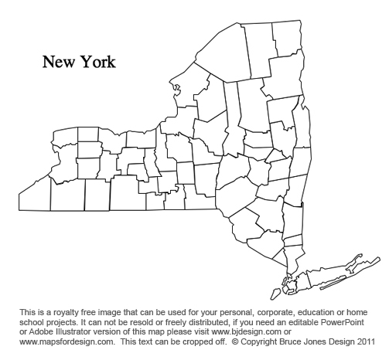
-Alliance for Better Communities, Jefferson County
-Community Coalition for Family Wellness, South Glens Falls
-Cortland Area Communities That Care, Cortland County
-HOPE Chautauqua, Chautauqua County
-Massapequa Takes Action, Massapequa
-Partnership for Ontario County, Ontario County
-Putnam County Communities That Care, Putnam County
-Tackling Youth Substance Abuse (TYSA), Staten Island
-TEAM Newburgh, Newburgh
-West Side Youth Development, Buffalo (West Side)
Alliance for Better Communities
Community Coalition for Family Wellness
Finger Lakes PRC
Central PRC
West Side Youth Development
Western PRC
Partnership for Ontario County
Cortland Area Communities That Care
HOPE Chautauqua
MHudson PRC
Putnam County Communities That Care
TEAM Newburgh
TYSA – Staten Island
Long Island PRC
NYC PRC
Massapequa Takes Action

Slide 26
2015-2016 PFS Lessons Learned
Adapted Environmental Strategies need fidelity guidelines
Specific and targeted Social Marketing messages are most effective
Community collaboration is key to effective implementation

Slide 27
Prevention Resource Centers
Training and TA for coalitions & providers in SPF, Environmental Strategies, planning, EBP, evaluation.
Collaborate with National Guard’s Counter Drug Task Force
Delivering SAPST for Prevention Providers
  129 staff trained in 2016

Slide 28
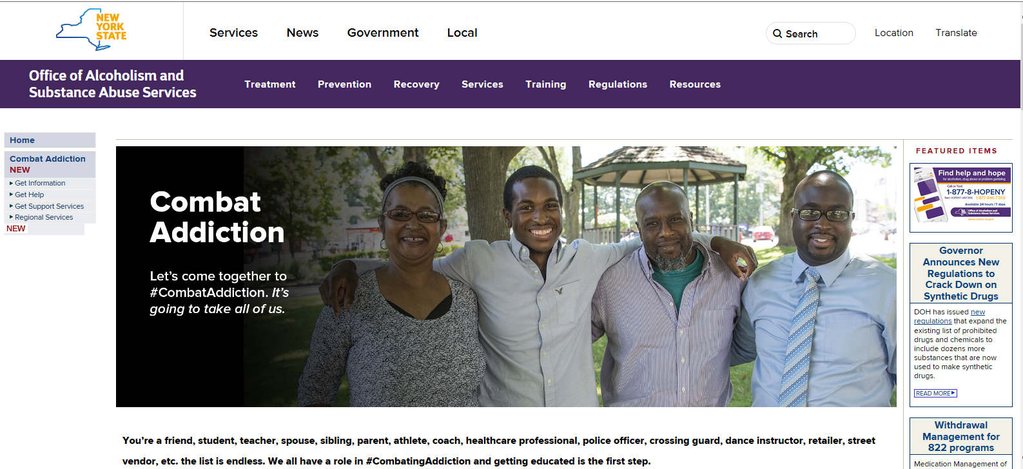

Slide 29
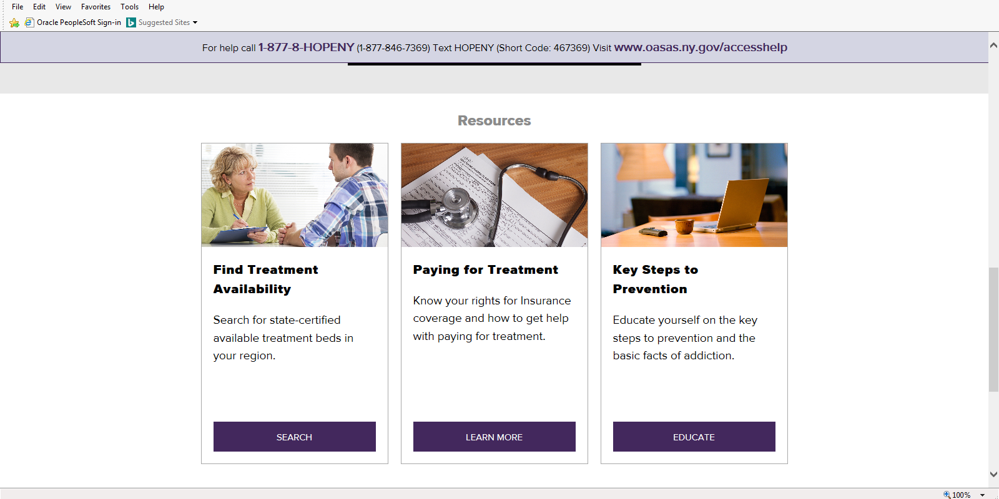

Slide 30


Slide 31


Slide 32
Environmental Strategies Training
Support implementation and reporting of Environmental Strategies
Discrepancies noted in reporting
  Not all components reported or delivered, messaging not focused
Created a plan to reach all entities involved to support Environmental Strategies
PIRE delivered a training for Field Office, Prevention staff and PRCs
PRCs scheduled to deliver Environmental Strategies Training over the next four months

Slide 33
Problem Gambling Prevention and Treatment Services
• 6 Inpatient Problem Gambling Treatment Program
• 19 Outpatient Problem Gambling Treatment Programs
– 9 Stand alone programs
– 10 822 with waiver programs
Currently two other programs are looking to complete the waiver process to become eligible to admit and treat for problem gambling only clients.
All 822 providers are required to screen for problem gambling.

Slide 34
Prevention of Problem Gambling
161 OASAS Prevention Providers
Three providers in the NYC region who are providing targeted Problem Gambling messaging
  Asian American population
  Hispanic population
  Jewish Orthodox population
One Statewide prevention resource
Statewide training on PG
Statewide Public Awareness Campaign
Center for Excellence
Two Grant Funded projects:
    Media Advocacy – YOUth Decide - awareness of PG among adolescents and parents
    Problem Gambling Training Partnership(PGTP)

Slide 35
Efforts moving forward
RFP for Statewide Problem Gambling Services
Statewide public awareness and education
7 Regional Problem Gambling Resource Centers
Problem Gambling Training Project
  OASAS, NYCPG, NYS Chapter of the National Association of Social Workers (NASW-NYS) , New York Mental Health Counselors Association, New York Association for Marriage and Family Therapy, and the National Association for the Advancement of Psychoanalysis (NAAP)
  Responsible Play Partnership
    OASAS, NYCPG, and the NYS Gaming Commission

