Slide 1
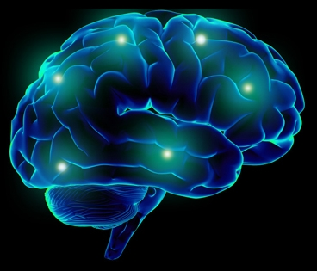
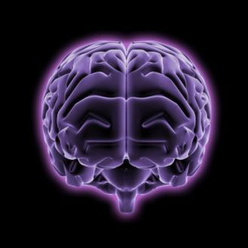
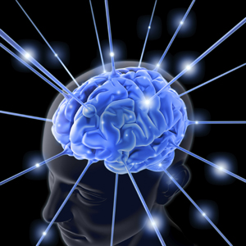



PRESCRITION DRUG ABUSE and the ELDERLY
GREGORY BUNT, M.D.
Clinical Assistant Professor of Psychiatry
NYU School of Medicine
Interim Medical Director Samaritan Daytop Village
Immediate Past President New York Society of Addiction Medicine
President International Society of Addiction Medicine

Slide 2
ISAM-ASAM
Definition of Addiction
Short Definition of Addiction:
Addiction is a primary, chronic disease of brain reward, motivation, memory and related circuitry. Dysfunction in these circuits leads to characteristic biological, psychological, social and spiritual manifestations. This is reflected in an individual pathologically pursuing reward and/or relief by substance use and other behaviors.
Addiction is characterized by inability to consistently abstain, impairment in behavioral control, craving, diminished recognition of significant problems with one’s behaviors and interpersonal relationships, and a dysfunctional emotional response. Like other chronic diseases, addiction often involves cycles of relapse and remission. Without treatment or engagement in recovery activities, addiction is progressive and can result in disability or premature death.

Slide 3
Alcohol and substance abuse among the elderly is a hidden national epidemic.
It is believed that about 10% of this country’s population abuses alcohol, but surveys revealed that as many as 17% of the over-65 adults have an alcohol-abuse problem.

Slide 4
Older adults are at risk for prescription drug abuse because they take more prescription medicines than other age groups.
Americans 65 years of age or older make up only 13% of the U.S. population, yet they consume approximately 33% of all prescription drugs.

Slide 5
Older adults are also at risk for prescription drug abuse because they often take more than one prescription medicine each day. This increases the risk for mistakes when taking the medicines and for drug interactions.

Slide 6
In addition, growing older slows down your liver’s ability to filter medicines out of your body.
This means that an older adult might become addicted to or have side effects from a prescription drug at a lower dose than a younger adult.

Slide 7
Elderly alcohol/drug abusers can be divided into two general types:
"hardy survivors," those who have been abusing alcohol and/or drugs for many years and have reached 65
"late onset" group, those who begin abusing
  alcohol and/or drugs later in life

Slide 8
The late onset alcohol and/or drug abuse is often triggered by changes in life such as:
retirement
death or separation from family/spouse
familial conflict
medical/health problems
reduced income
impairment of sleep
familial conflict

Slide 9
Education for and from healthcare providers, family and pharmacies
Simple screening tests such as the AUDIT-C, CAGE and/or the Short Michigan Alcoholism Screening Test - Geriatric Version (S-MAST-G)
Clinical treatment may need to be considered, as well as pharmacological interventions as a possible adjunct to clinical treatment. Naltrexone appears to work as well in the elderly as in other groups of alcohol -dependent patients to decrease the craving and feeling of elation related to alcohol
Twelve-Step, self-help and support group

Slide 10
A family’s attention to the elderly family member’s daily life can be extremely helpful in identifying medical and social problems.
It is important to develop a medication inventory for an elderly person. This inventory is a list of all of his or her prescribed and OTC medications. The final inventory usually uncovers a surprising number of OTC medications (some studies have shown as many as nine different medications used per month). This list of medications can be brought to a local pharmacist where a drug - drug interaction list can be generated

Slide 11
The following risk factors can increase an older person's chance for developing substance abuse:
Living alone
Family history of substance abuse
Earlier substance abuse
Mental health disorders
Chronic pain
Boredom
Insomnia

Slide 12
A person can abuse any type of prescription drug, but elderly adults commonly take two types of medicines that have a high potential for addiction:
Opioids
Benzodiazepines

Slide 13
Opioids are prescription drugs used to control pain.
They include medicines such as oxycodone (OxyContin), oxycodone combined with acetaminophen (Percocet), and hydrocodone combined with acetaminophen (Vicodin).
A person can become addicted to opioids if he or she takes an opioid for a long period of time or if he or she takes too much of the opioid.

Slide 14
Benzodiazepines are prescription drugs used to treat anxiety, panic attacks, or insomnia.
They include medicines such as diazepam (Valium), alprazolam (Xanax), clonazepam (Klonopin), and lorazepam (Ativan).
A person can become addicted to and feel like he or she needs more of these drugs if the medicine is taken for a long period of time.

Slide 15

Behavioral correlates
Mood
Anxiety
Irritability
Pain
Cognitive
Insomnia
Notes:
PROTRACTED WITHDRAWAL WITHDRAWAL V. RE-INFORCEMENT CRAVINGS
CONDITIONED WITHDRAWAL - OBRIEN

Slide 16
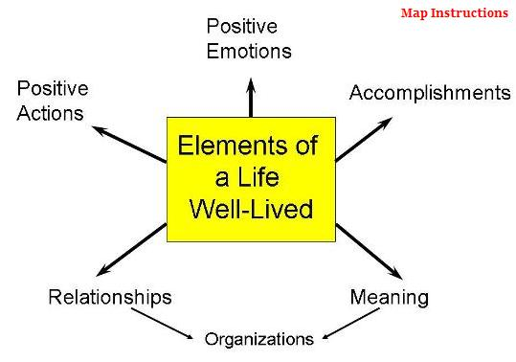
Notes:
HOW TO GO BEYOND AND TRANSCEND TREATING ILLNESS TO ELEVATING THE QUALITY AND FULFILLMENT OF THE GOOD LIFE

