Slide 1
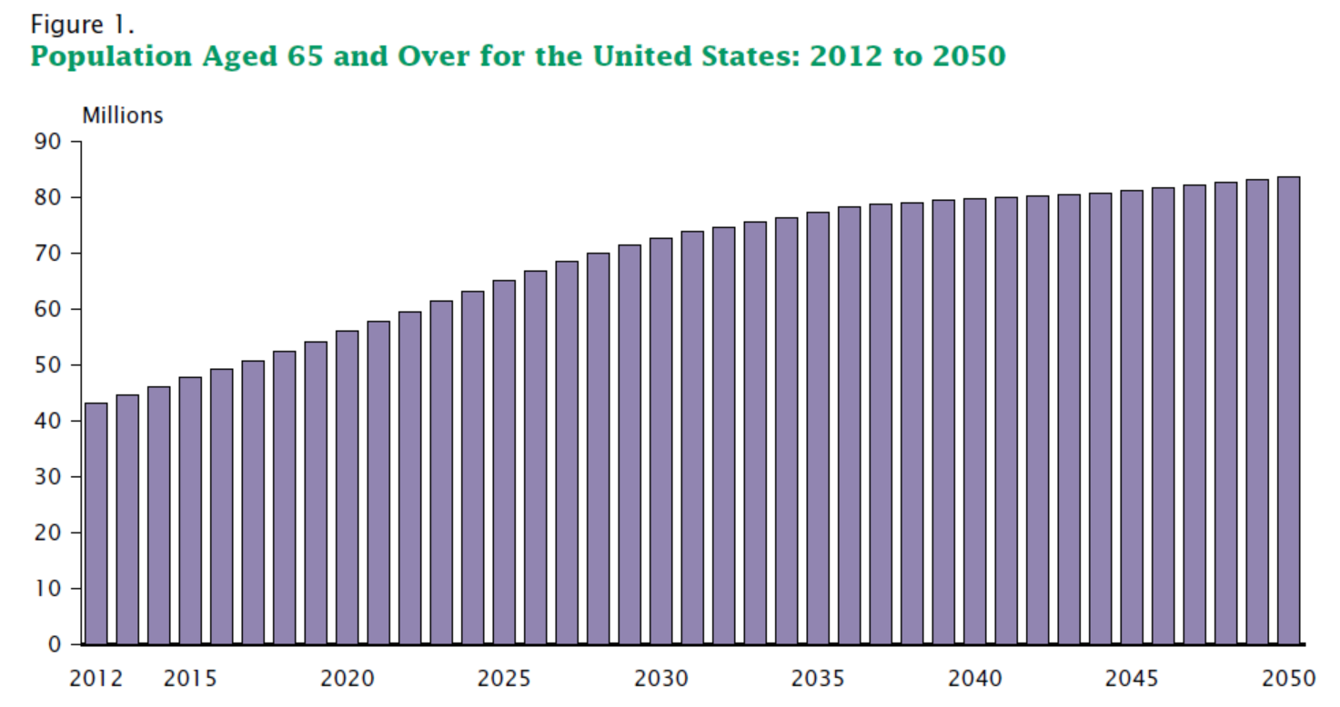
US Census Data
Ortman, Jennifer M., Victoria A. Velkoff, and Howard Hogan. An Aging Nation: The Older Population in the United States, Current Population Reports, P25-1140. U.S. Census Bureau, Washington, DC. 2014.

Slide 2
Substance Use Prevalence
Source: 2014 SAMHSA NSDUH

Slide 3
Baby Boom Cohort
In 2014, only 26 percent of persons aged 65 or older (i.e., born before 1950) had ever used illicit drugs in their lifetime
Lifetime rates of use were 54 percent for those aged 60 to 64 (born in 1950 to 1954)
Lifetime rates of use were above 50 percent for each age group from ages 20 to 59 (born after 1954)
(NSDUH, 2014)

Slide 4


Slide 5


Slide 6


Slide 7
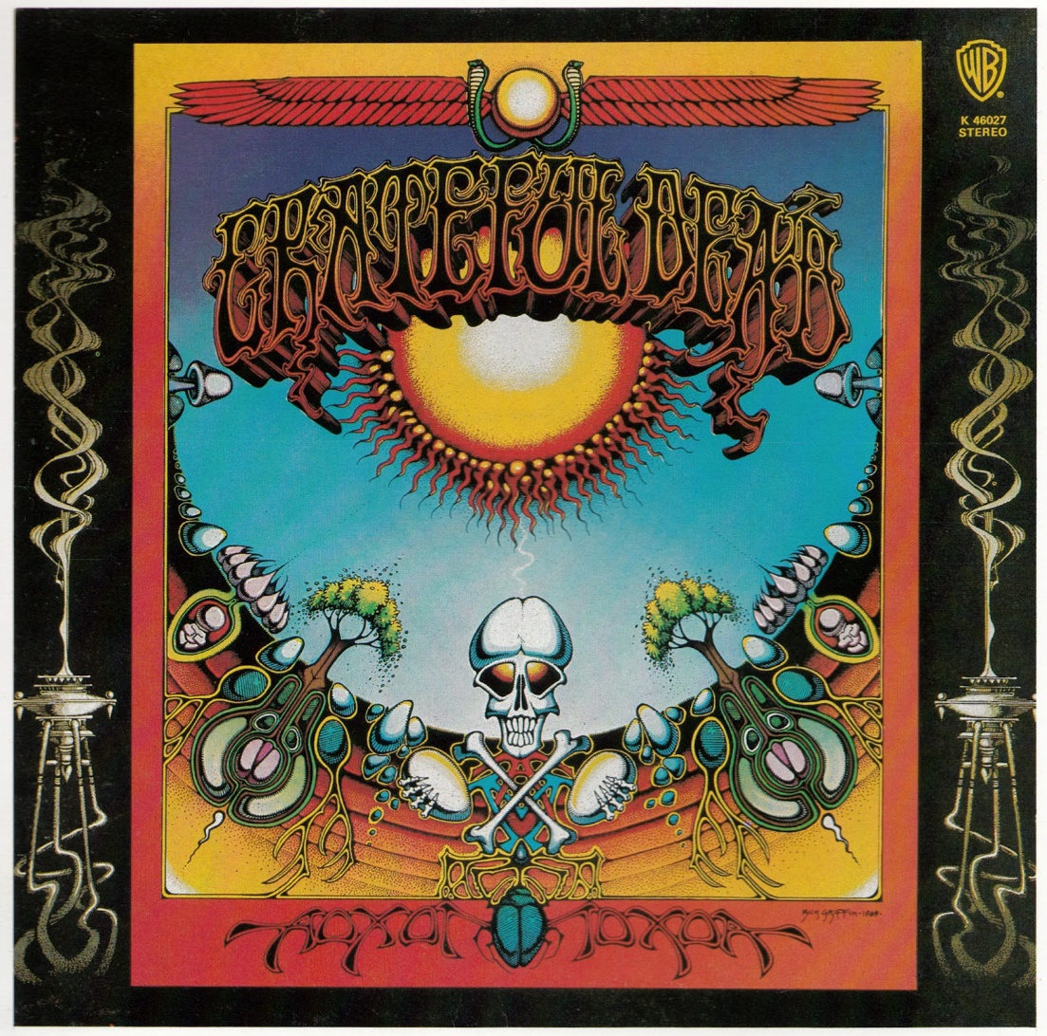

Slide 8
SUD Treatment Data
National drug admissions among those 55 and older increased by 81 percent between 2003 and 2013. In the same period, national drug admissions for those aged 50-54 grew 47 percent
During the same time, overall drug admissions for those aged 49 and younger decreased by 16 percent
(SAMHSA TEDS, 2013)

Slide 9
SUD Treatment in New York
2003-2013 Adults age 56+
74 percent increase in older adult admissions
83 percent increase in heroin (10 percent in 2000, 19 percent in 2013)
375 percent increase in nonmedical use of other opiates/synthetics (1 percent 2000, 4 percent 2013)
(SAMHSA TEDS, 2013)

Slide 10
Physical and Mental Health Comorbidities of
Older Adults

Slide 11
Depression
Healthy Aging report by the CDC identified depression as an emerging public health issue that affects older adults (CDC, 2007)
Prevalence of depression in community dwelling older adults is as high as 20 percent (DHHS, 1999)
Older alcoholics are three times as likely to exhibit major depressive disorders than non-alcoholics
(SAMHSA, 2005)

Slide 12
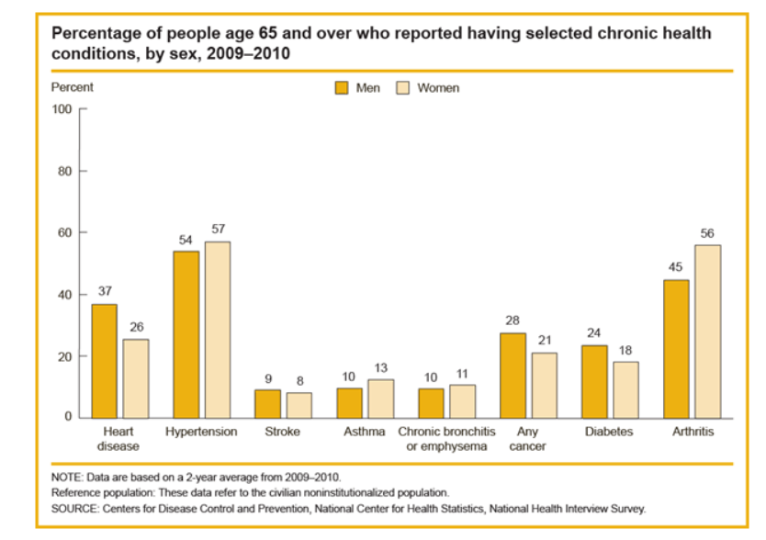
Common chronic health conditions of older adults
Source: Health and Retirement Study 2012

Slide 13
Evolution of Odyssey House
ElderCare Program
Pre-1997: Separate groups for clients aged 55+ in residential treatment
1997: Private funding establishes discreet 15-bed residential unit
1999: Capacity expands to 40 beds
2004: in response to “Project 2015. State Agencies Prepare for the Impact of an Aging New York”, OASAS increases residential capacity to 68 funded beds, private funding establishes outpatient services
2014: NYS DOH funds community-based recovery support services; OMH funds integrated primary care
2015: Residential program moves to new facility on Wards Island and capacity expands to 89 beds

Slide 14
Odyssey House ElderCare Program
Demographics (2015) n= 197:
  69 percent African-American, 22 percent Hispanic,
  8 percent White
  Average age: 60
  Age Range: 52 - 74
  54 percent report completing HS or obtaining GED
  46 percent have criminal justice involvement at admission
  44 percent are homeless
  Approximately 18 percent of ElderCare residents report a mental health condition at admission
  21 percent report having a major physical health condition
  83 percent report at least one prior treatment episode

Slide 15
Odyssey House ElderCare Program Data 2015
Primary Substances of Abuse
  Alcohol - 44 percent
  Crack/cocaine - 23 percent
  Heroin - 28 percent
56 percent report poly-substance use

Slide 16
Odyssey House ElderCare Program
2014 Utilization/Retention Outcomes
Utilization Rate (capacity of 67 beds) | 95%
1 Month Retention | 99%
3 Month Retention | 85%
Completed or Referred | 71%

Slide 17
ElderCare Services
Evidence-based practices
Service enhancements
Seeking Safety
Motivational Enhancement Therapy
Addiction Medications
SAMHSA’s relapse prevention for older adults
Wellness self management
Thinking for a change
Nursing case management
Medication Independence protocol
Recovery coach peer mentoring
Yoga
Vocational rehabilitation
Family therapy

Slide 18
Exploratory Study (2004) n=68
Independent Variable- 2 groups
Late-in-life users
Life-long users
Dependent Variables
Depression
Anxiety
Motivation for treatment

Slide 19
Preliminary Findings
Life-long users
Predominate substances are alcohol and opioid
More prior treatment
More medical co-morbidities
More criminal justice involvement
Higher level of motivation toward treatment
Late-in-life users
Predominate substance is cocaine/crack
Trend toward higher levels of depression
Trauma precedes problem substance use
All women studied

Slide 20
Odyssey House Integrated Care Grant (2014-2016) for Older Adults
3 year project funded by New York State Office of Mental Health
Purpose is to establish behavioral health care services in a physical health care setting
The target population for the this program is individuals 55 years and older, who suffer from a substance use disorder and/or co-occurring SUD and mental health disorder

Slide 21
Odyssey House Integrated Care Grant for Older Adults
Results to Date:
  52 percent of ElderCare clients identified as being at-risk, or have a physical or mental health condition
  Of these:
    67 percent at risk for an anxiety disorder
    56 percent at risk for a depressive disorder

Slide 22
Call To Action
Increase resources dedicated to identifying and treating older adults with alcohol and substance abuse
Need for more specialized treatment services conforming to the special needs of older adults
More research into alternate therapies/pharmacology for older adults with substance use disorders
Need to increase public awareness regarding prevalence of substance use disorders among older adults

