Slide 1
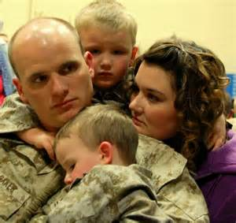
T.R.U.C.E.: A Holistic Approach to Treating Veterans and Their Families
Notes:
Note to all providers: Find yourself importance as providers
mission, vision, theme, elements of treatment that directly relate to theme
Policy, procedure is almost universal, methodology should be unique to you, what you do and who you are as an agency (trauma-informed, etc.)
Provides comfort to staff, universal goal and direction for services that act as filter for treatment
Allows for better staff communication, common language, and purpose finding for recipients is easier

Slide 2
Zachary Randolph MA, MAC, CASAC, CAMS-1
St Joseph’s Addiction Treatment & Recovery Centers
Col. C. David Merkel, M.D. Veteran Residence
Notes:
Who am I? Where did I come from? My time in service experience, my education, my worldview

Slide 3
Invictus
Out of the night that covers me,
Black as the Pit from pole to pole,
I thank whatever gods may be
For my unconquerable soul.
In the fell clutch of circumstance
I have not winced nor cried aloud.
Under the bludgeonings of chance
My head is bloody, but unbowed.
Beyond this place of wrath and tears
Looms but the Horror of the shade,
And yet the menace of the years
Finds, and shall find, me unafraid.
It matters not how strait the gate,
How charged with punishments the scroll.
I am the master of my fate:
I am the captain of my soul.
- William Ernest Henley
Notes:
Invictus – Unconquered Soul
Service members trained to never give up, never quit, fight on
Takes a lot for them to accept concepts like “defeated” “give up” “lost the battle”

Slide 4
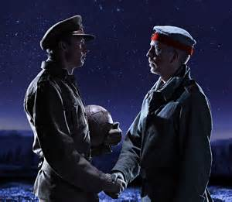
Why a Truce?
Notes:
we say, call a truce, DEFINE TRUCE “an agreement between enemies or opponents to stop fighting or arguing for a certain time”

Slide 5
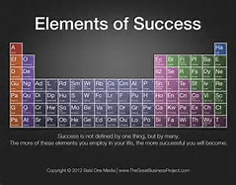
What is T.R.U.C.E.
Notes:
It’s the elements of a successful treatment experience (theme: Experiencing Recovery):
Time
Respite
Unconditional Positive Regard
Connection
Experience

Slide 6

Time
Notes:
To tell one’s story (any and all histories to be detailed, processed, shared, challenged and reframed to find peace)
Holistic, on-going assessment (BPS is living, always be adding and tweaking and articulating – it helps the resident find a clearer image of self)
Stabilization – of symptoms, gain grounding skills, coping skills, resiliency skills
Time to experience failures and collect successes/positive life experiences suing new skills and beliefs
Time to gain insight into self, purpose, others

Slide 7
Based on Assessment
Notes:
Q1: The length of treatment allows time to address the identified areas of my needs
Q2: This treatment episode has given me the time to feel stabilized physically, mentally, emotionally
Q3: I have had the time to experience healthy challenges, failures, and successes throughout the course of treatment
Q4: The amount of time at this program has allowed me to understand myself, my motives and my internal values better
Q5: How does the current length of treatment compare to previous treatment episodes

Slide 8
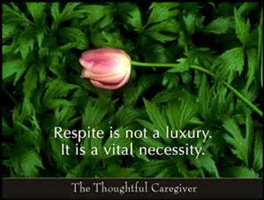
Respite
Notes:
Crisis interventions
Safety: physical, mental, emotional
Trauma-Informed care
Resiliency and strength-based interventions

Slide 9
Based on Assessment
Notes:
Q6: This program taught me the skills to stay safe in times of personal crisis
Q7: I have learned to use emotional intelligence in order to find a sense of calm personally and in my surroundings
Q8: During my treatment I have learned what being trauma-informed means and how to apply it
Q9: During this treatment episode I have learned what resiliency is and have been able to apply it regularly
Q10: Compared to prior treatment episodes, I feel like I have found more rest and inner-peace this time

Slide 10

Unconditional Positive Regard
Notes:
Carl Rogers and then Albert Ellis Unconditional other and self acceptance
Establish worth
Empowerment of individual, group and family
identification of strengths, needs, abilities and preferences
Motivation
Identification of values

Slide 11
Based on Assessment
Notes:
Q11: I have identified a greater sense of self-worth during treatment
Q12: I have been able to identify my personal value system and learned how to apply it
Q13: I have learned how to empower myself to attain personal goals and advocate for myself
Q14: Compared to prior treatment episodes, I feel a more positive sense of self-worth this time

Slide 12
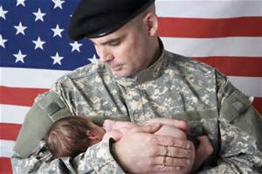
Connection
Notes:
Congruence of thoughts, feelings, behaviors
Relationships
Cultural sensitivity and integration
Social responsibility
Open communication
Resources
Supports
reintegration

Slide 13
Based on Assessment
Notes:
Q15: I have been able to reconcile with significant relationships or found peace with past relationships
Q16: I have learned how to align my thinking with my values and feelings
Q17: I have a sense of social responsibility to those around me
Q18: I have learned new support networks, resources and relational contacts to increase my social network
Q19: Compared to prior treatment episodes, I have been able to create healthier connections at this time

Slide 14

Experience
Notes:
Exposure
Education
Evidence vs. history
Practice
Social learning
Growth & Change

Slide 15
Based on Assessment
Notes:
Q20: I have been able to expose myself to experiences that allow the application of new skills
Q21: I have learned new information to apply to this treatment experience
Q22: I have had new experiences that have helped reframe negative past experiences
Q23: I understand the importance of social learning from staff and my peers
Q24: I am open to growth and change in my life and recovery
Q25: Compared to prior treatment episodes, I have had more beneifical experiences focused on recovery and reintegration

