Slide 1

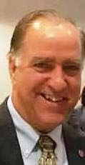
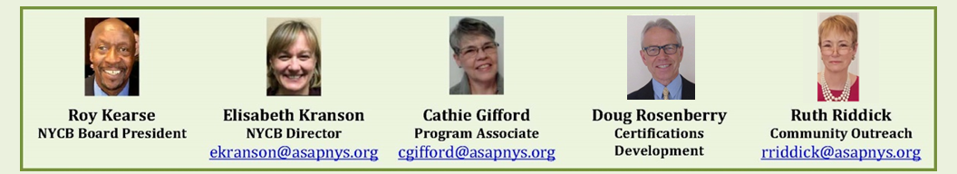
ASAP-NYCB
2012-2022
“We are committed to excellence in everything we do.”
- John Coppola, ASAP Executive Director

