Slide 1
Racism as a Public Mental Health Crisis
June 23, 2022
Matthew Canuteson, Chief Diversity Officer, New York State Office of Mental Health

Slide 2
Office of Mental Health’s Equity Strategy
The New York State Office of Mental Health believes everyone should have an equal opportunity for mental wellness. This means removing obstacles and implementing services and policies aimed at reducing disparities in access, quality, and treatment outcomes for historically marginalized, underserved and unserved populations. These populations include but are not limited to; people of color, members of the LBGTQ community, older adults, rural New Yorkers, Veterans, immigrants, people with disabilities (including physical), and people who have limited English proficiency.

Slide 3
Definition: Health Inequities
“Health inequities are avoidable inequalities in health between groups of people within countries and between countries. These inequities arise from inequalities within and between societies. Social and economic conditions and their effects on people’s lives determine their risk of illness and the actions taken to prevent them becoming ill or treat illness when it occurs (WHO, 2018).”

Slide 4
“Particular type of health difference that is closely linked with social, economic, and/or environmental disadvantage. Health disparities adversely affect groups of people who have systematically experienced greater obstacles to health based on their racial or ethnic group; religion; socioeconomic status; gender; age; mental health; cognitive, sensory, or physical disability; sexual orientation or gender identity; geographic location; or other characteristics historically linked to discrimination or exclusion (SAMHSA 2018)”.
Definition: Disparities

Slide 5
Reducing Disparities
Disparities
Adequately Collecting and Using Data
Workforce Diversity/Inclusion
Training Mentoring/Supervision
Cultural Competence, Humility, Addressing Implicit Bias
Policy, Compliance, Regulation
Notes:
Matt

Slide 6
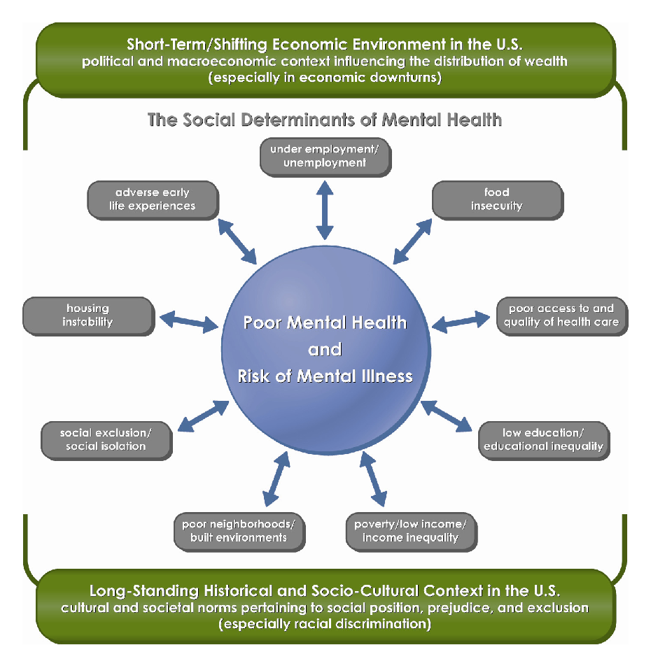
(Compton and Shim, 2015)

Slide 7
Mental Health Disparities - Special Populations
Asian American males, in grades 9-12, were 30% more likely to consider attempting suicide as compared to non-Hispanic white male students, in 2019
Black and African American individuals are more often diagnosed with schizophrenia and less often diagnosed with mood disorders compared to white people with the same symptoms. Additionally, they are offered medication or therapy at the lower rates than the general population
46% of LGBTQ youth report they wanted psychological or emotional counseling from a mental health professional but were unable to receive it in the past 12 months
American Indian and Alaskan Native individuals report experiencing serious psychological distress 2.5 times more than the general population over a month’s time
U.S. Department of Health and Human Services, Mental Health America, Trevor Project, CDC

Slide 8
Mental Health Housing and Racial Disparities - Causes
History - from slavery to segregation, people of color have been denied rights and socioeconomic opportunities. The disproportionality in homelessness is a by-product of systemic inequity: effects of racism continue to perpetuate disparities in critical areas that impact rates of homelessness.
Poverty - is a strong predictor of homelessness. Black and Latinx groups are overrepresented in poverty relative to their representation in the overall population - with rates of 10.8% and 7.6% percent, respectively.
Criminal Justice - people of color are overrepresented in the criminal justice system
A criminal history can keep people from successfully passing background checks to secure both housing and employment
People exiting jails and prisons often face significant problems in accessing safe and affordable housing and their rate of homelessness is high.

Slide 9
COVID-19 Disparities
Communities of color experience disproportionately higher rates of COVID-19 cases and deaths
Non-Hispanic Black adults (48%) and Hispanic or Latino adults (46%) are more likely to report symptoms of anxiety and/or depressive disorder than Non-Hispanic White adults (41%)
Historically, these communities of color have faced challenges accessing mental health care
Black parents more often than White parents have reported negative impacts of the pandemic on their children’s education, their ability to care for their children, and their relationships with family members
https://www.kff.org/coronavirus-covid-19/issue-brief/the-implications-of-covid-19-for-mental-health-and-substance-use/

Slide 10
Social Determinants of Mental Health (NYS MH System)
2017 PCS Sample, n=103,416
Educational Attainment | NHW | NHB | Hispanic | Other
<12 years | 11.0% | 28.3% | 34.3% | 17.2%
12th grade/high school graduate | 39.3% | 40.1% | 36.0% | 31.0%
>12th grade | 49.7% | 31.6% | 29.8% | 51.8%
Criminal Justice Involvement | NHW | NHB | Hispanic | Other
Current Criminal Justice Involvement | 10.8% | 17.2% | 10.3% | 7.5%
Employment Status | NHW | NHB | Hispanic | Other
Unemployed | 73.9% | 86.3% | 82.0% | 75.1%
Employed Part-Time | 12.4% | 5.6% | 8.1% | 11.5%
Employed Full-Time | 13.8% | 8.1% | 10.0% | 13.4%
Homelessness | NHW | NHB | Hispanic | Other
Homelessness within the Past Six Months | 5.4% | 12.7% | 8.9% | 6.7%

Slide 11
National CLAS Standards
National Standards for Culturally and Linguistically Appropriate Services (CLAS) are intended to advance health equity, improve quality, and help eliminate health care disparities by establishing a blueprint for health and health care organizations to:
Principal Standard
Provide effective, equitable, understandable, and respectful quality care and services that are responsive to diverse cultural health beliefs and practices, preferred languages, health literacy, and other communication needs

Slide 12
OMH’s Recent Policy Advances to Address Disparities
Soliciting stakeholder input and feedback from the Statewide Multicultural Advisory Committee; a 25 member advisory committee whose membership includes consumers of services, experts in the field, policy makers and researchers
Progress and phased in release of the Vital Signs Dashboard, depicting racial, ethnic, and gender-based disparities in NY’s mental health system (currently in OMH clinics, full system release later in 2022)
The inclusion of equity language in all RFP’s being exclusively released by OMH, based on the National CLAS Standards
Actively working to uniformly include the National CLAS Standards into additional regulatory, policy and funding mechanisms

Slide 13
OMH’s Recent Policy Advances to Address Disparities
Embarking on a structural racism organizational assessment process with the NKI-Center for Research for Cultural and Structural Equity to identify agency policies and practices that contribute to racial inequities in NY’s mental health system
Emerging collaboration with SUNY and CUNY to implement diversity pipeline programs to increase the level of diversity in NY’s MH workforce
Working with the Center of Practice Innovations (CPI) to hire a Diversity and Inclusion Officer who will work to implement an online training curriculum to support broad mental health system adoption of the best practice approaches to reducing disparities

Slide 14
Where Do We Go From Here?
Increased use of data to leverage disparities reduction activities
Internal and organizational self-reflection
Further formalizing and solidifying increased expectations for system performance
Systemically addressing trauma in marginalized communities

Slide 15
Questions/Discussion

Slide 16
Contact
Matthew Canuteson, MA
Chief Diversity Officer
New York State Office of Mental Health
Matthew.Canuteson@omh.ny.gov

